Slide 1
Towards more accurate microbial source tracking via non-negative matrix factorization (NMF)
Ziyi Huang⁺, Dehan Cai⁺, Yanni Sun*
City University of Hong Kong
https://yannisun.github.io/
July 13, 2024
Notes:
Hello everyone, I am Dehan, a Ph.D. student from the City University of Hong Kong. My supervisor is Prof. Yanni Sun. Today, I will share our work for microbial source tracking using non-negative matrix factorization.

Slide 2
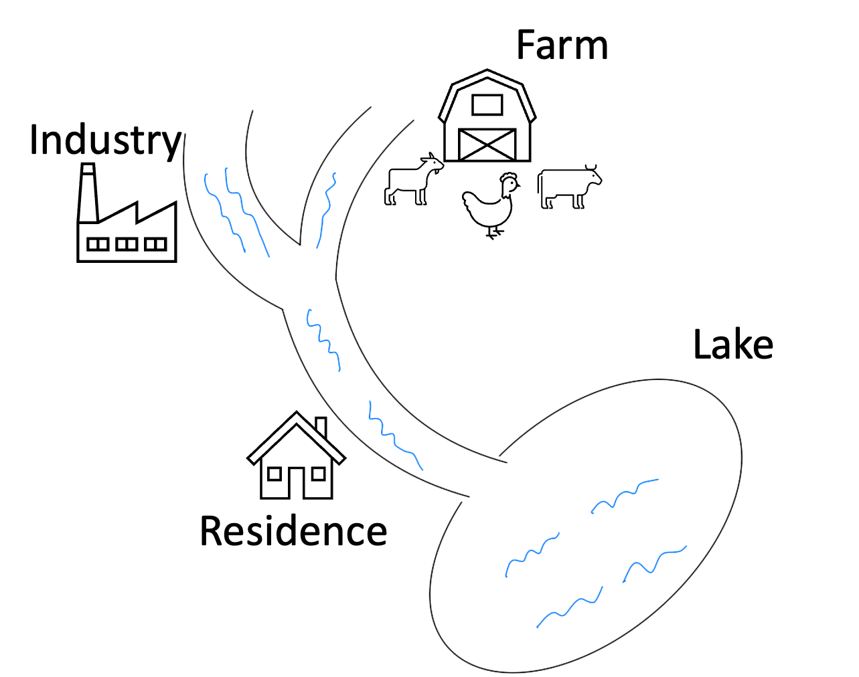
Sources of Lake Pollution: Who is Responsible?
Issue: Poor water quality due to microbial pollution
Potential Polluters: Industry, farms, residences
Action: Sampling lake and surrounding sources
Goal: Identify pollution sources (microbial source tracking, MST)
Notes:
Here is a picture showing a river flowing into a lake. Along the river, there are industrial sites, farms, and residential areas. One day, people noticed that the water quality in the lake had gotten worse due to microbial pollution. To determine the source of this pollution, researchers sampled the lake and the surrounding areas to find out where the microbial contamination was coming from.

Slide 3
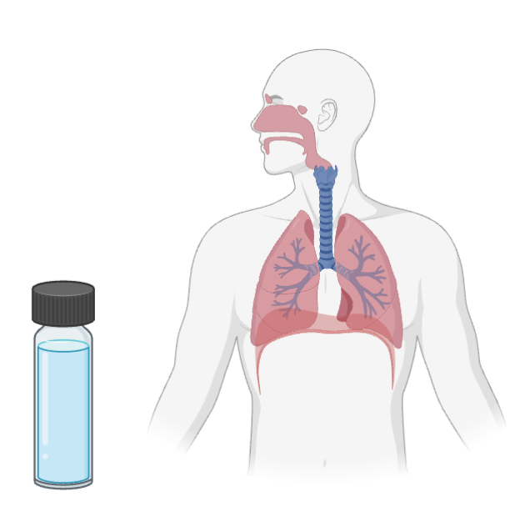
Microbial Source Tracking (MST): overview
Microbial Source Tracking
Input: a target/sink sample and multiple source samples from other microbial communities
Goal: to determine the contribution of each source to the target.
Applications
﻿Quantifying contamination
- Laboratory contamination: the target sample may be contaminated
by sampling procedures, reagents, indoor air, etc.
- Water contamination
Microbial interaction analysis
- Microbial interaction between humans and the indoor environment
microbial contamination from the upper respiratory tract
nose
pharynx
lung
bronchoalveolar lavage fluid (BLF)
Pic source: https://app.biorender.com/
Notes:
In this story, the microbiomes in the lake sample may come from multiple sources. Microbial source tracking helps us determine the proportion of each source in the sample. This method has many applications, like identifying contamination, as I just mentioned. We can also use it to analyze microbial interactions.

Slide 4

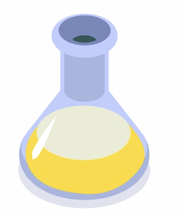
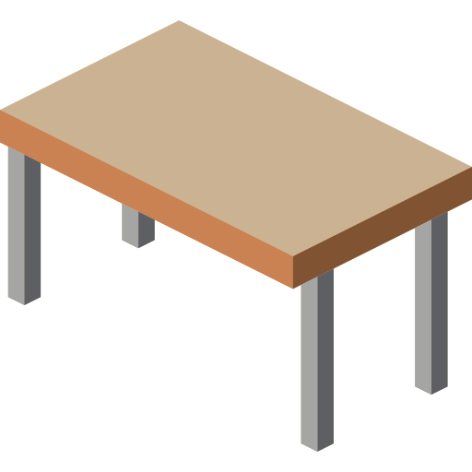
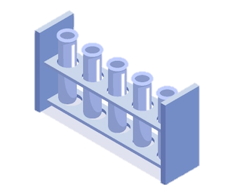
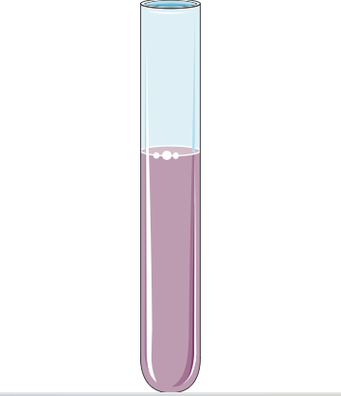
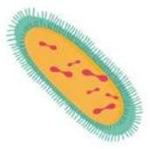
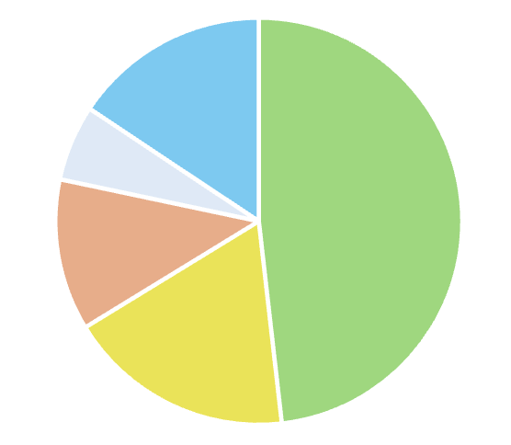

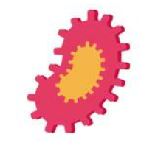



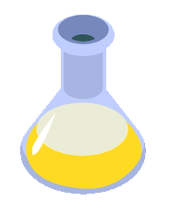


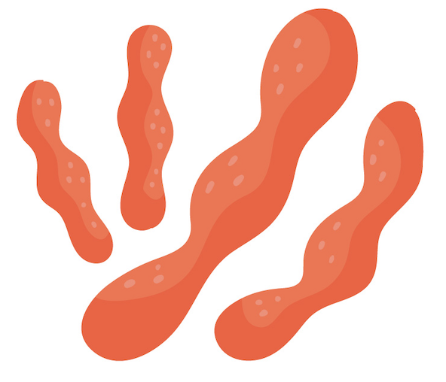
Input data: taxa abundance
Example: Tracking laboratory contamination
Microbial Samples
Taxa abundance
Potential (reference) sources
Potential (reference) sources
Target sample
Source contributions
…
…
Sequencing
10 | 0 | 3 | 0 | …
29 | 27 | 0 | 0 | …
0 | 45 | 33 | 0 | …
33 | 12 | 0 | 23 | …
17 | 13 | 0 | 57 | …
0 | 0 | 78 | 20 | …
22 | 0 | 12 | … | …
… | … | … | … | …
37
15
22
33
15
7
12
…
MST
?
A sink sample
Taxonomic profiling
…
…
Figure sources: https://bioicons.com/
Notes:
Here’s an example of tracking laboratory contamination. We have a target sample and some possible contamination sources. By performing sequencing and taxonomic profiling, we get the taxa abundance for each potential source and the target sample. In this table, the numbers represent the read counts of taxa. If the target sample is contaminated by some sources in the lab, it will likely share some common taxa with those sources. By analyzing the taxa abundance, we can determine the contributions of each source, as shown in this pie chart.

Slide 5
Challenges
Potential (reference) sources
Reference sources
…
Irrelevant sources
Unknown/unseen sources
Similar sources
Sequencing noises
10 | 0 | 3 | 0 | …
29 | 27 | 0 | 0 | …
0 | 45 | 33 | 0 | …
33 | 12 | 0 | 23 | …
17 | 13 | 0 | 57 | …
0 | 0 | 78 | 20 | …
22 | 0 | 12 | … | …
… | … | … | … | …
?
State-of-the-art tools
SourceTracker^{[1]}
FEAST^{[2]}
…
[1] Knights, Dan, et al. "Bayesian community-wide culture-independent microbial source tracking." Nature methods 8.9 (2011): 761-763.
[2] Shenhav, Liat, et al. "FEAST: fast expectation-maximization for microbial source tracking." Nature methods 16.7 (2019): 627-632.
Notes:
However, accurately estimating the source contributions to the target sample from their taxa abundance is not easy.
First, there may exist irrelevant sources. If they share some taxa with the target sample, identifying them from true sources becomes challenging.
Second, the reference sources might not cover all contributing sources to the target sample, so we need to estimate the proportion of unknown sources.
Third, some sources have similar microbial distributions. So, estimating their proportions is not trivial.
And, sequencing noise can affect taxonomic profiling, further complicating source tracking.
Here are two microbial source tracking tools. They’re widely used to estimate the proportions of sources in a target sample. But despite their popularity, they can sometimes give very different results because of the challenges I just mentioned. So, accurately estimating the contributions of sources, especially the unknown sources, is still a challenging task.

Slide 6

Method
Notes:
In the following slides, I will share our method for microbial source tracking using non-negative matrix factorization.

Slide 7



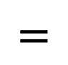
Non-negative Matrix Factorization (NMF)
Non-negative Matrix Factorization
Target
…
?
0.3
0.1
0.2
…
…
…
…
…
… | … | … | … | … | …
… | … | … | … | … | …
… | … | … | … | … | …
… | … | … | … | … | …
… | … | … | … | … | …
… | … | … | … | … | …
… | … | … | … | … | …
… | … | … | … | … | …
…
…
…
…
…
…
X : relative taxa abundance of the target sample
W: relative taxa abundance matrix of sources
H: proportion (contribution) of sources
? : Unknown sources
$$=$$
$$×$$
…
?
X is given.
Our goal: find W and H
…
…
X
(observed)
W
H
Notes:
In this non-negative matrix factorization problem, our goal is to break down the taxa abundance matrix of the target sample into two matrices. The blue one represents the normalized taxa abundance distribution for each potential source. The orange one shows the proportions of each source contributing to the target sample. To estimate the proportion of unknown sources, we add a column for the taxa abundance distribution of unknown sources in the blue matrix and an extra entry for the proportion of unknown sources in the orange matrix. Because we don’t know the exact number of unknown sources, we only estimate their total proportion.

Slide 8

Adding reference sources
Input
Non-negative Matrix Factorization
…
Target
…
?
0.3
0.1
0.2
…
…
…
…
…
… | … | … | … | … | …
… | … | … | … | … | …
… | … | … | … | … | …
… | … | … | … | … | …
… | … | … | … | … | …
… | … | … | … | … | …
… | … | … | … | … | …
… | … | … | … | … | …
Output
0.1 | 0 | 0.1 | 0 | …
0.2 | 0.2 | 0 | 0 | …
0 | 0.4 | 0.3 | 0 | …
0.3 | 0.1 | 0 | 0.2 | …
0.1 | 0.1 | 0 | 0.3 | …
0 | 0 | 0.2 | 0.1 | …
0.3 | 0 | 0 | … | …
… | … | … | … | …
…
…
…
…
…
…
$$=$$
$$×$$
…
?
…
…
…
Y
(observed)
X
(observed)
W
H
Similar
Y: observed taxa abundance of reference sources
Notes:
In the matrix factorization, it is difficult to obtain the desire the blue matrix without the any reference. So, we added a constraint that the taxa abundance distribution should be similar to the given observed taxa abundance of the reference sources. We don't have the observed taxa abundance for unknown sources, so the constraint was not applied to the last column in the blue matrix. This is the overview of our tool called SourceID-NMF. The input to it are the normalized taxa abundance of reference sources and a target sample. Then, it output the estimating proportions of each reference source and the unknown source.

Slide 9
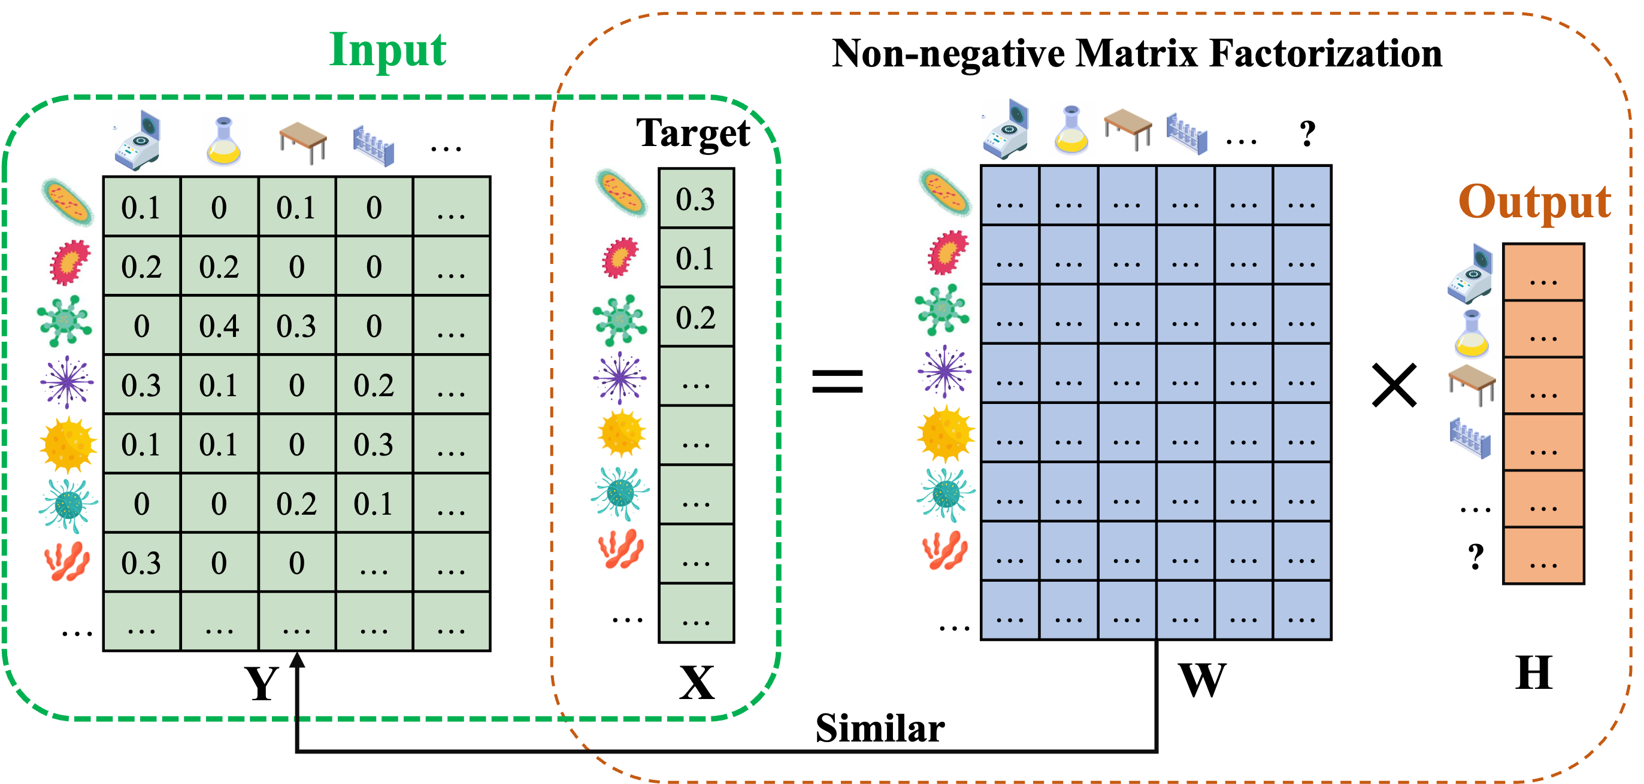
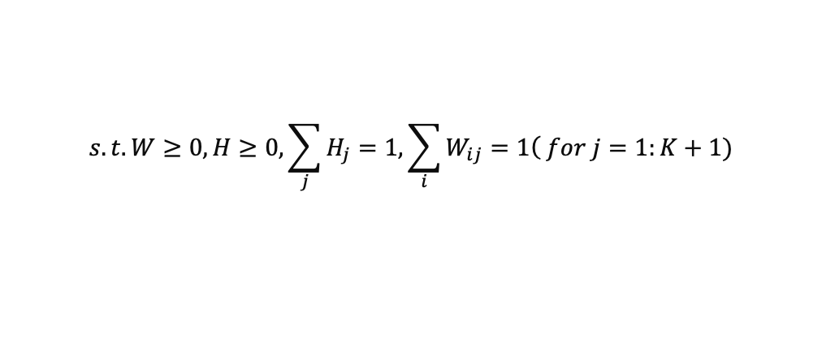
SourceID-NMF: optimization objective
Optimization Problem
$$\underset{W,H}{argmin}{\frac{1}{2}{\left\|X−WH\right\|}_{F}^{2}+\frac{1}{2}{\left\|A◦\left(W−Y\right)\right\|}_{F}^{2}}$$
$$s.t.W≥0, H≥0, \sum_{j}{H_{j}}=1, \sum_{i}{W_{ij}}=1\left( for j=1:K+1)\right.$$
X: taxa abundance of a sample
Y : observed taxa abundance of reference sources
W: taxa abundance of sources (to be estimated)
H : mixing proportion of sources (to be estimated)
? : Unknown sources
A: the last column is all 0 and other elements are 1
Notes:
Here is our optimization problem. The orange component is the matrix factorization part, the blue component is the constraint on the reference sources. And the values in the matrix should be non-negative and normalized.
Frobenius Norm
Hadamard product operator

Slide 10

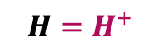

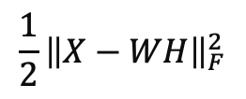
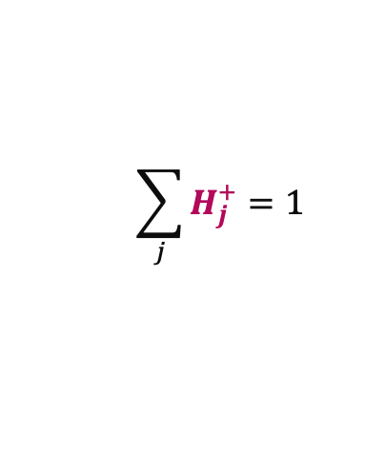
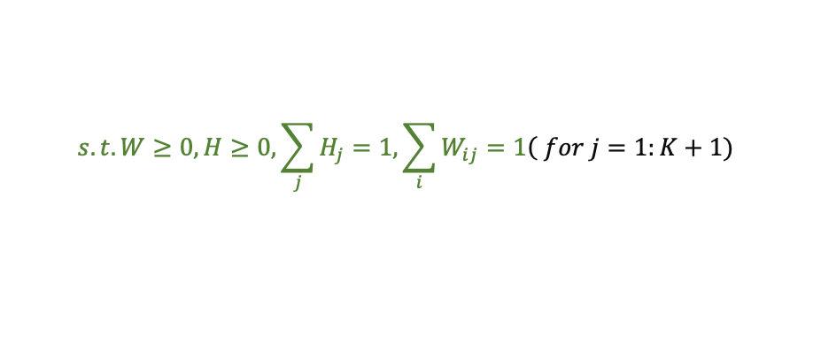
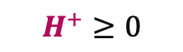
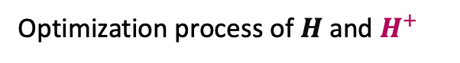
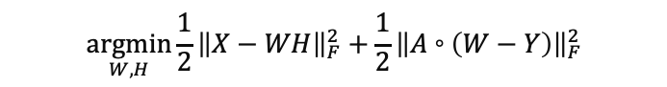
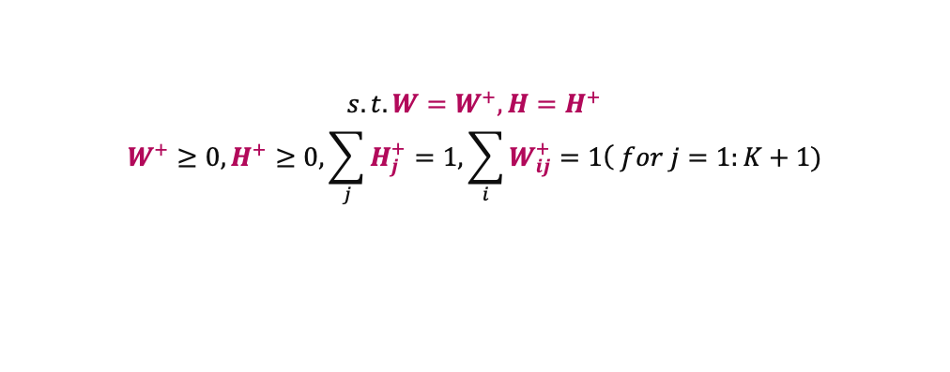

SourceID-NMF: optimization method (ADMM)
Optimization Problem
Optimization process of $H$ and $H^{+}$
$$\underset{W,H}{argmin}{\frac{1}{2}{\left\|X−WH\right\|}_{F}^{2}+\frac{1}{2}{\left\|A◦\left(W−Y\right)\right\|}_{F}^{2}}$$
$$\frac{1}{2}{\left\|X−WH\right\|}_{F}^{2}$$
$$\sum_{j}{H_{j}^{+}}=1$$
$$H^{+}≥0$$
$$s.t.W≥0, H≥0, \sum_{j}{H_{j}}=1, \sum_{i}{W_{ij}}=1\left( for j=1:K+1)\right.$$
Alternating Direction Method of Multipliers (ADMM)^{[1]}
$$H$$
$$H=H^{+}$$
$$H^{+}$$
$$\underset{W^{+},H^{+}, W,H}{argmin}{\frac{1}{2}{\left\|X−WH\right\|}_{F}^{2}+\frac{1}{2}{\left\|A◦\left(W^{+}−Y\right)\right\|}_{F}^{2}}$$
$$s.t.W=W^{+}, H=H^{+}$$
$$W^{+}≥0, H^{+}≥0, \sum_{j}{H_{j}^{+}}=1, \sum_{i}{W_{ij}^{+}}=1\left( for j=1:K+1)\right.$$
auxiliary variables: $W^{+}$, $H^{+}$
[1] Boyd, S. et al. (2011). Distributed optimization and statistical learning via the alternating direction method of multipliers. Foundations and Trends® in Machine learning, 3(1), 1–122.
Notes:
(about 2mins)
In this problem, we try to find the values for W and H to minimize our objective function with some constraints. Because W and H have these constraints, optimizing them isn’t straightforward.
To address this, we use the ADMM algorithm. This algorithm breaks down the optimization process into more manageable parts by using auxiliary variables. This simplifies the optimization of W and H.
For example, imagine the yellow region represents our optimization region without considering constraints. The central point is the minimum value here. However, when we include the constraints (represented by the green region), the star shows the true minimum value we want.
In the optimization of H, we will ignore the green constraint. Instead, we mainly consider the component itself and the difference between H and its auxiliary variable H+. Similarly, when updating H+, we only consider non-negativity and normalization constraints, as well as the difference between H and H+.
By iteratively updating all these variables, we can estimate the optimal values for W and H. The graph here illustrates how the loss changes with each iteration.

Slide 11
Result
Notes:
Let me show you some results.

Slide 12
Experiment design
Testing SourceID-NMF on different datasets
Simulated data
Inter-source similarity
Irrelevant sources
Unknown sources
Sources with noises
Real data
Indoor environmental samples
Infant’s fecal samples
Metrics: contribution of sources (H)
Jensen-Shannon Divergence (JSD): the difference of true H and the estimated H
Pearson Correlation (PCC): the correlation between H and the estimated H
Compare with two state-of-the-art tools
SourceTracker^{[1]}
FEAST^{[2]}
[1] Knights, Dan, et al. "Bayesian community-wide culture-independent microbial source tracking." Nature methods 8.9 (2011): 761-763.
[2] Shenhav, Liat, et al. "FEAST: fast expectation-maximization for microbial source tracking." Nature methods 16.7 (2019): 627-632.
Notes:
We conducted both simulated and real data experiments. In the experiments, we consider several factors like sources similarity, irrelevant sources, unknown sources and ect.
And we used the Jensen-Shannon divergence and the Pearson correlation to evaluate the accuracy of the estimated source proportions by our tool and these two tools.

Slide 13
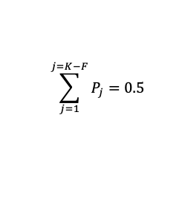
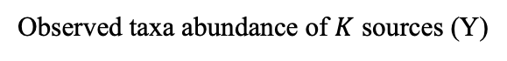
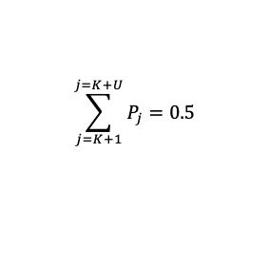
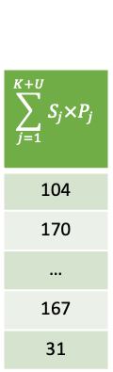
Simulated data settings
Simulated data process: how to obtain X (target) and Y (observed sources)
Taxa abundance (reads counts) of sources from the Earth’s microbiome project^{[1]}
Mixing proportions
Taxa abundance of X
S₁ | … | S_{K-F} | S_{K-F+1} | … | S_{K} | S_{K+1} | … | S_{K+U}
15 | … | 600 | 88 | … | 130 | 234 | … | 12
31 | … | 34 | 993 | … | 403 | 44 | … | 334
… | … | … | … | … | … | … | … | …
179 | … | 159 | 10 | … | 299 | 39 | … | 556
431 | … | 90 | 204 | … | 19 | 394 | … | 20
P₁ | … | P_{K-F} | P_{K-F+1} | … | P_{K} | P_{K+1} | … | P_{K+U}
0.05 | … | 0.16 | 0 | … | 0 | 0.2 | … | 0.3
$$\sum_{j=1}^{K+U}{S_{j}×P_{j}}$$
104
170
…
167
31
Taxon 1
Taxon 2
…
Taxon 1
…
$$\sum_{j=1}^{j=K−F}{P_{j}}=0.5$$
$$0$$
$$\sum_{j=K+1}^{j=K+U}{P_{j}}=0.5$$
Taxon 2
Taxon N
…
Other sources
proportions
Irrelevant sources
proportions
Unknown sources
proportion
…
Multinomial sampling
Taxon N
Observed taxa abundance of $K$ sources (Y)
Simulated data settings
S’₁ | … | S’_{K-F} | S’_{K-F+1} | … | S’_{K}
10 | … | 589 | 78 | … | 123
38 | … | 50 | 948 | … | 430
… | … | … | … | … | …
168 | … | 143 | 12 | … | 278
456 | … | 98 | 231 | … | 14
K (15) + U (5) = 20 sources with different similarities
Varying proportions of 5 unknown sources (0.1 to 0.9)
5 irrelevant sources in the 15 sources
[1] Thompson, L. R. et al. (2017). A communal catalogue reveals earth’s multiscale microbial diversity. Nature, 551(7681), 457–463.
Notes:
Here is the process to simulate the data. We used the taxa abundance of about 2000 sources from the Earth Microbiome Project. First, we selected some sources with specific similarities and assigned proportions to them. Like here the blue table and the orange table. Among these selected sources, some sources are labeled as irrelevant, meaning their proportions are zero, and some are labeled as unknown, so we don’t use them as reference. By mixing the taxa abundance of each source with the given proportions, we get the taxa abundance for the target sample. We then use multinomial sampling to obtain the observed taxa abundance of reference sources from the selected sources. The green and purple tables here are used as inputs for all the tools. Each time, we selected 20 sources to simulate the data. Among them, 5 are irrelevant, 5 are unknown, and in total 15 sources are as reference.

Slide 14
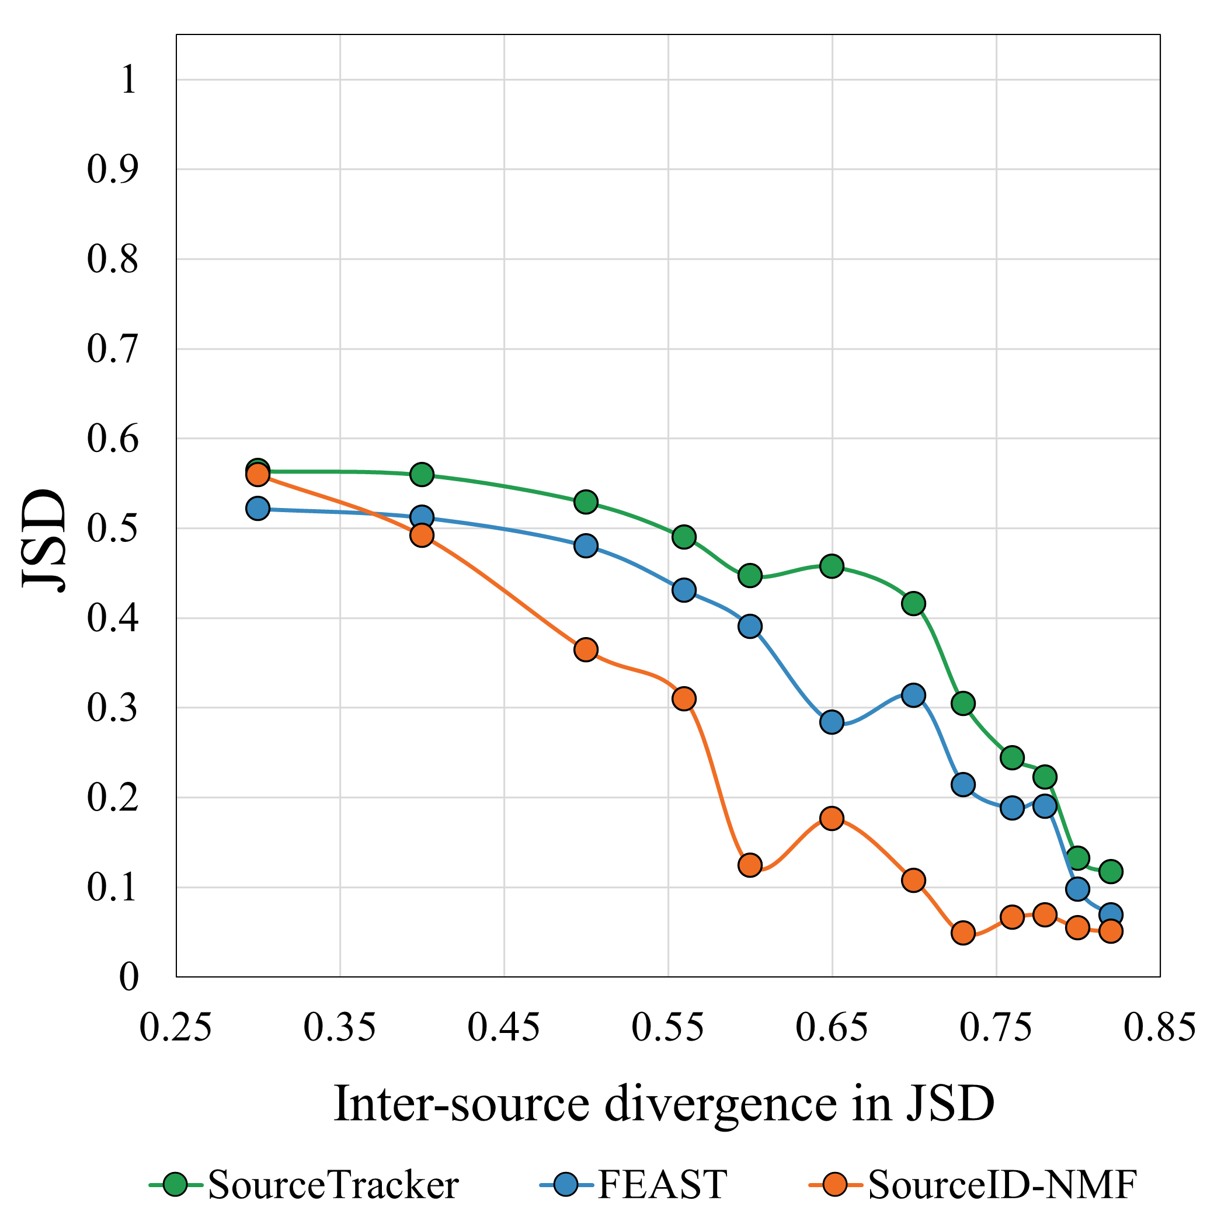
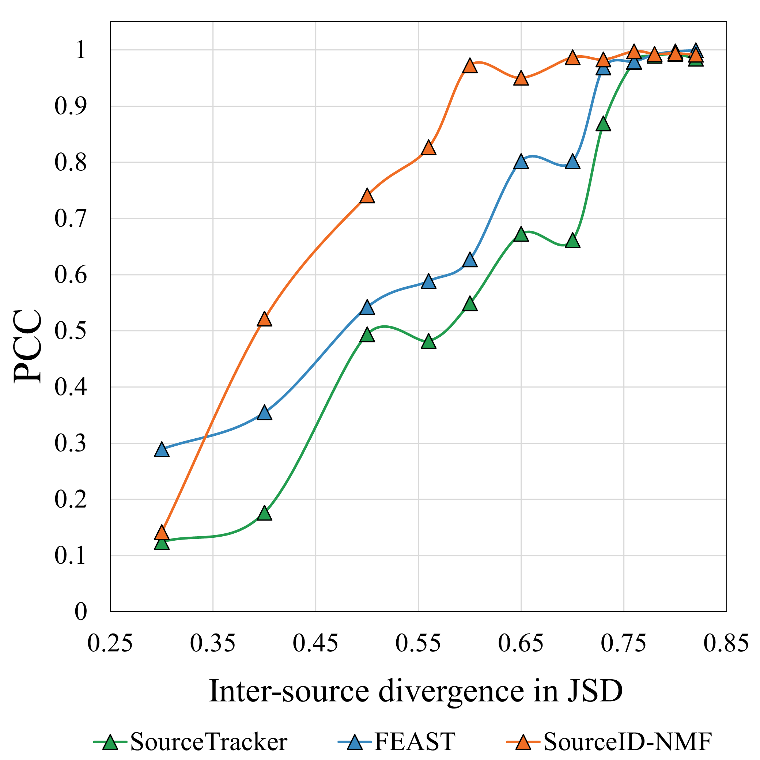
Simulated data experiment
Impact of inter-source similarity on source tracking: estimated H and the true H
Notes:
These two figures shows the performance of three tools with changes of inter-source similarity. We can see that our tool has better performance.

Slide 15
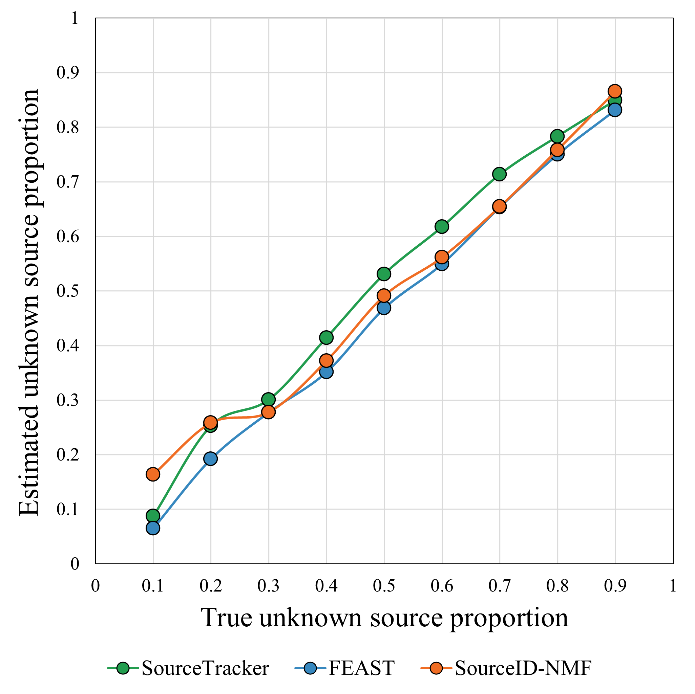
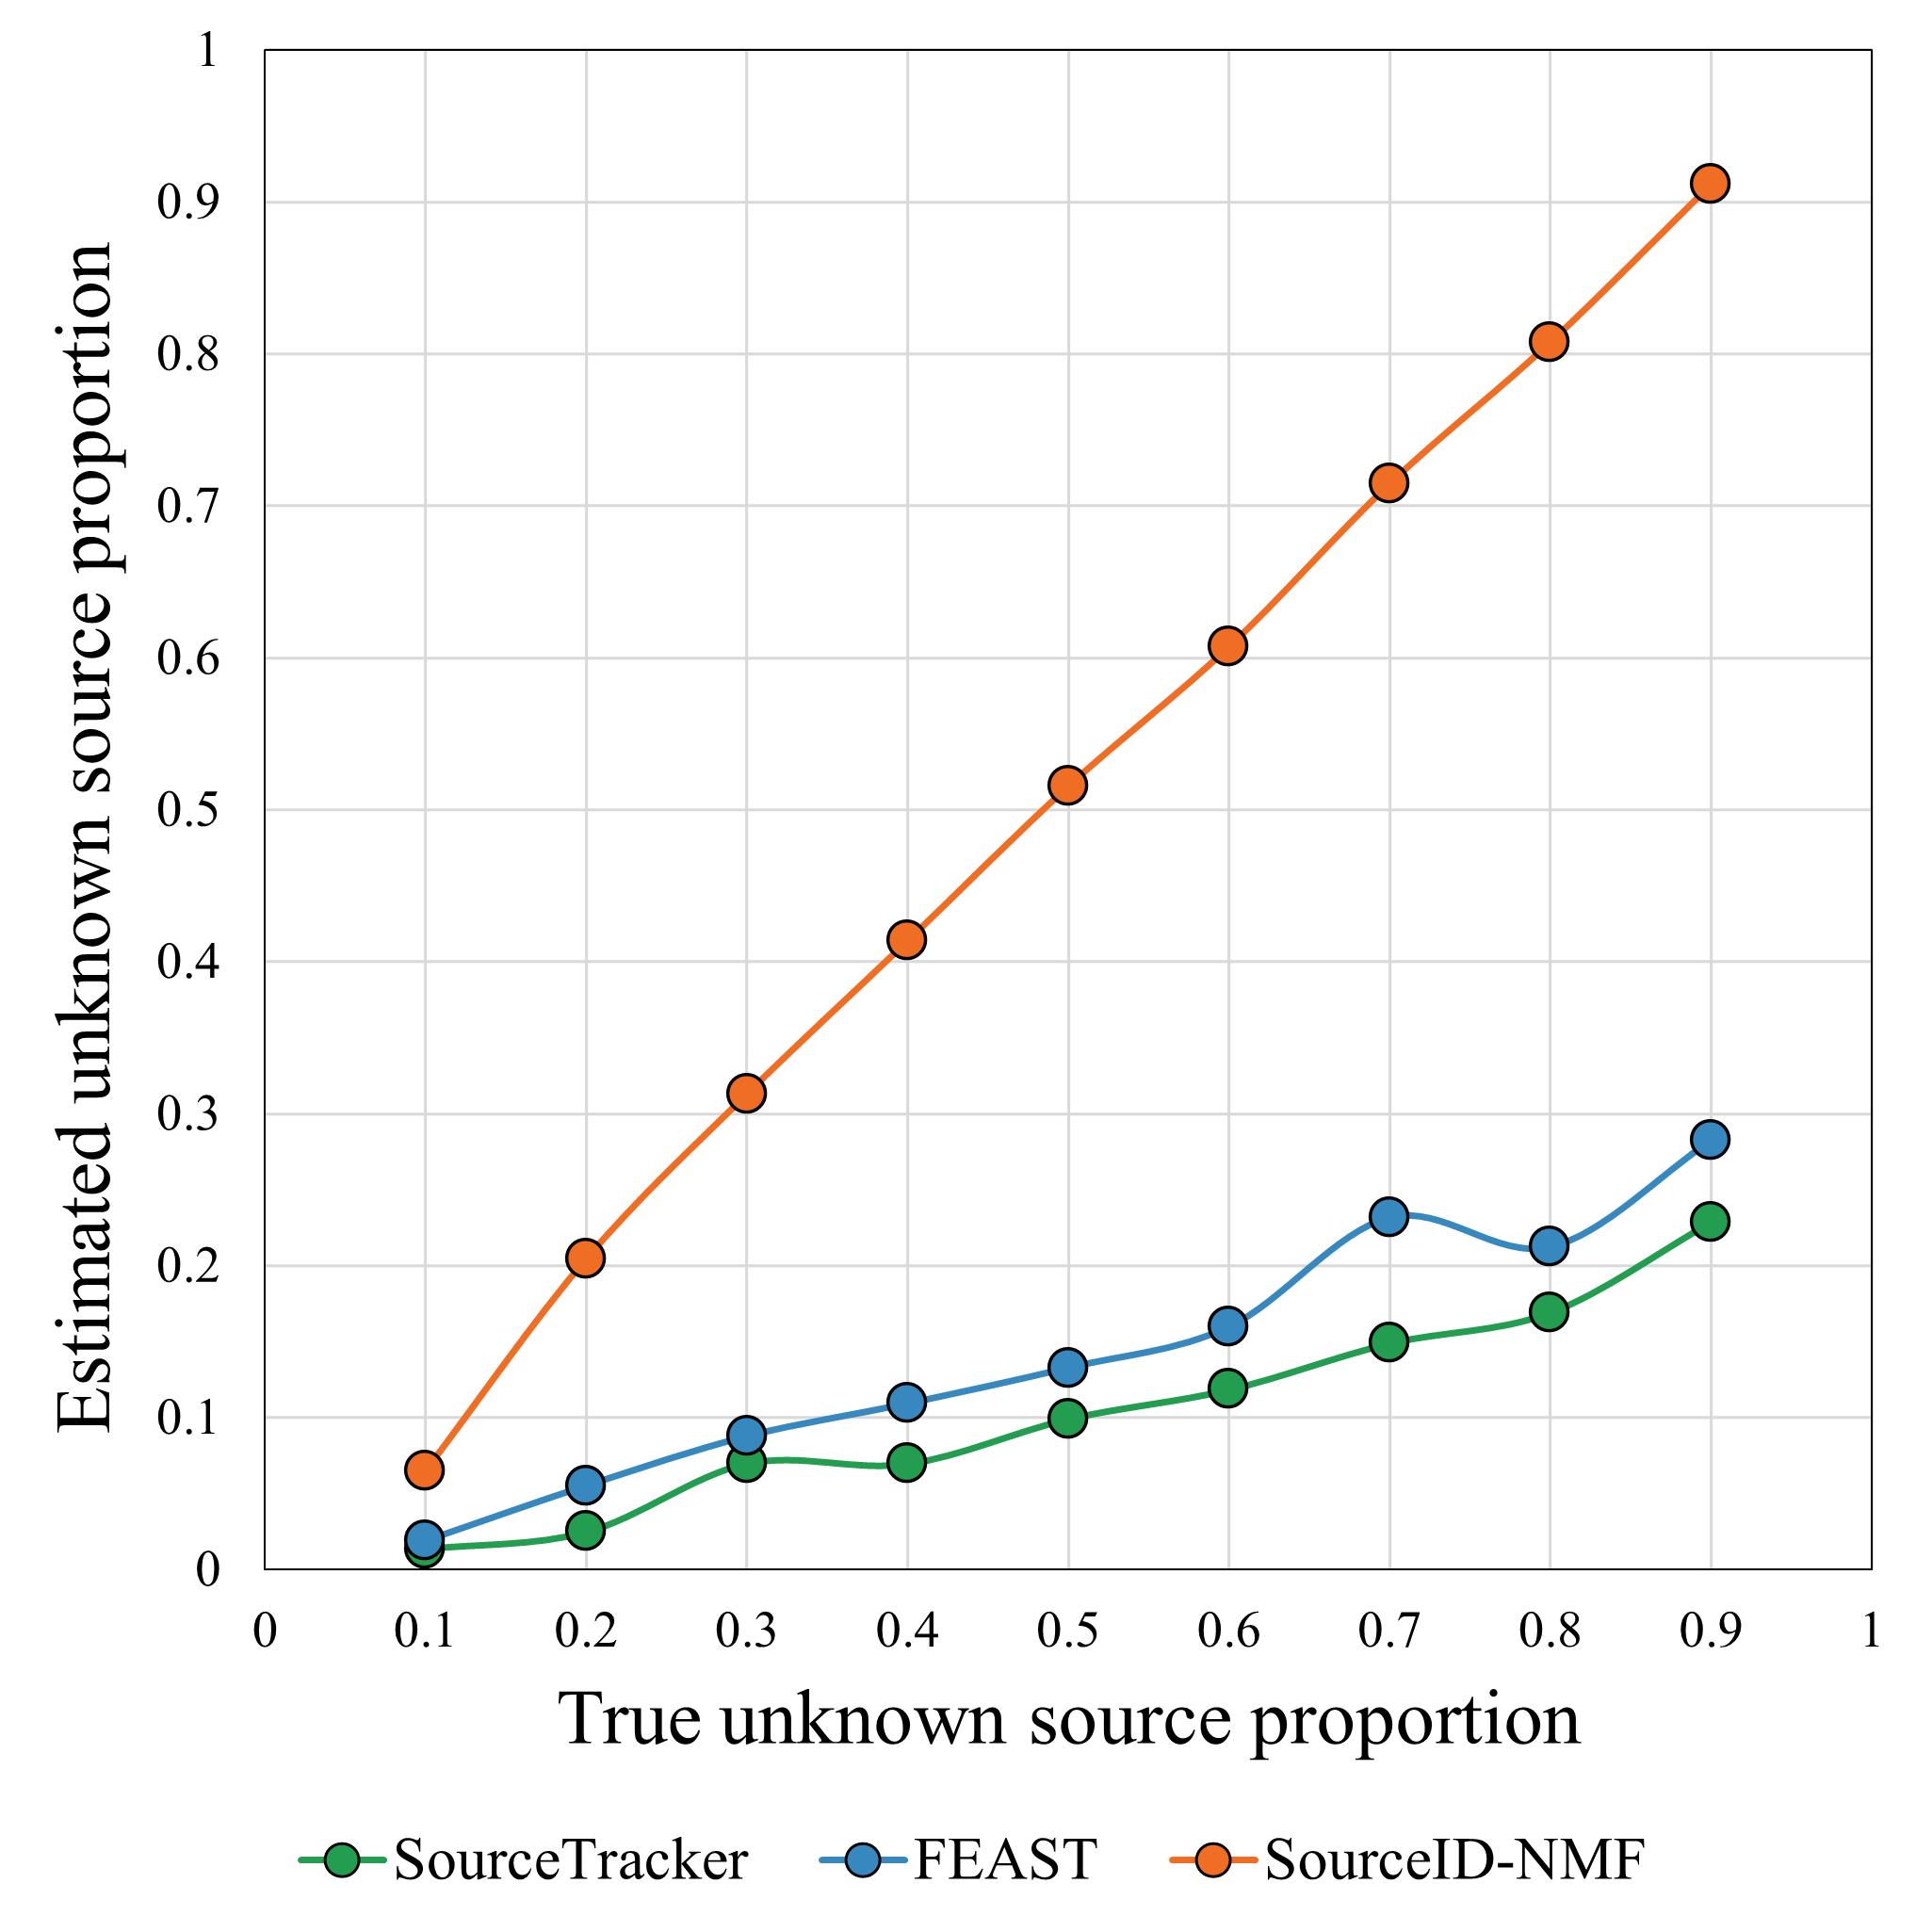
Simulated data experiment
SourceID-NMF has more accurate estimations of unknown sources’ proportion
(b) 0.8 JSD
(a) 0.6 JSD
Notes:
These two figures represent the estimation of the total proportion of unknown sources. On the X-axis, we have the ground truth proportions, the Y-axis is the estimated proportions. The first figure shows that all tools accurately estimated the proportion of unknown sources when the sources divergence is high. However, as sources become more similar, SourceTracker and FEAST underestimated the proportion of unknown sources,while overestimated other sources significantly. Our tool has the better performance in estimating the proportion of unknown sources.

Slide 16
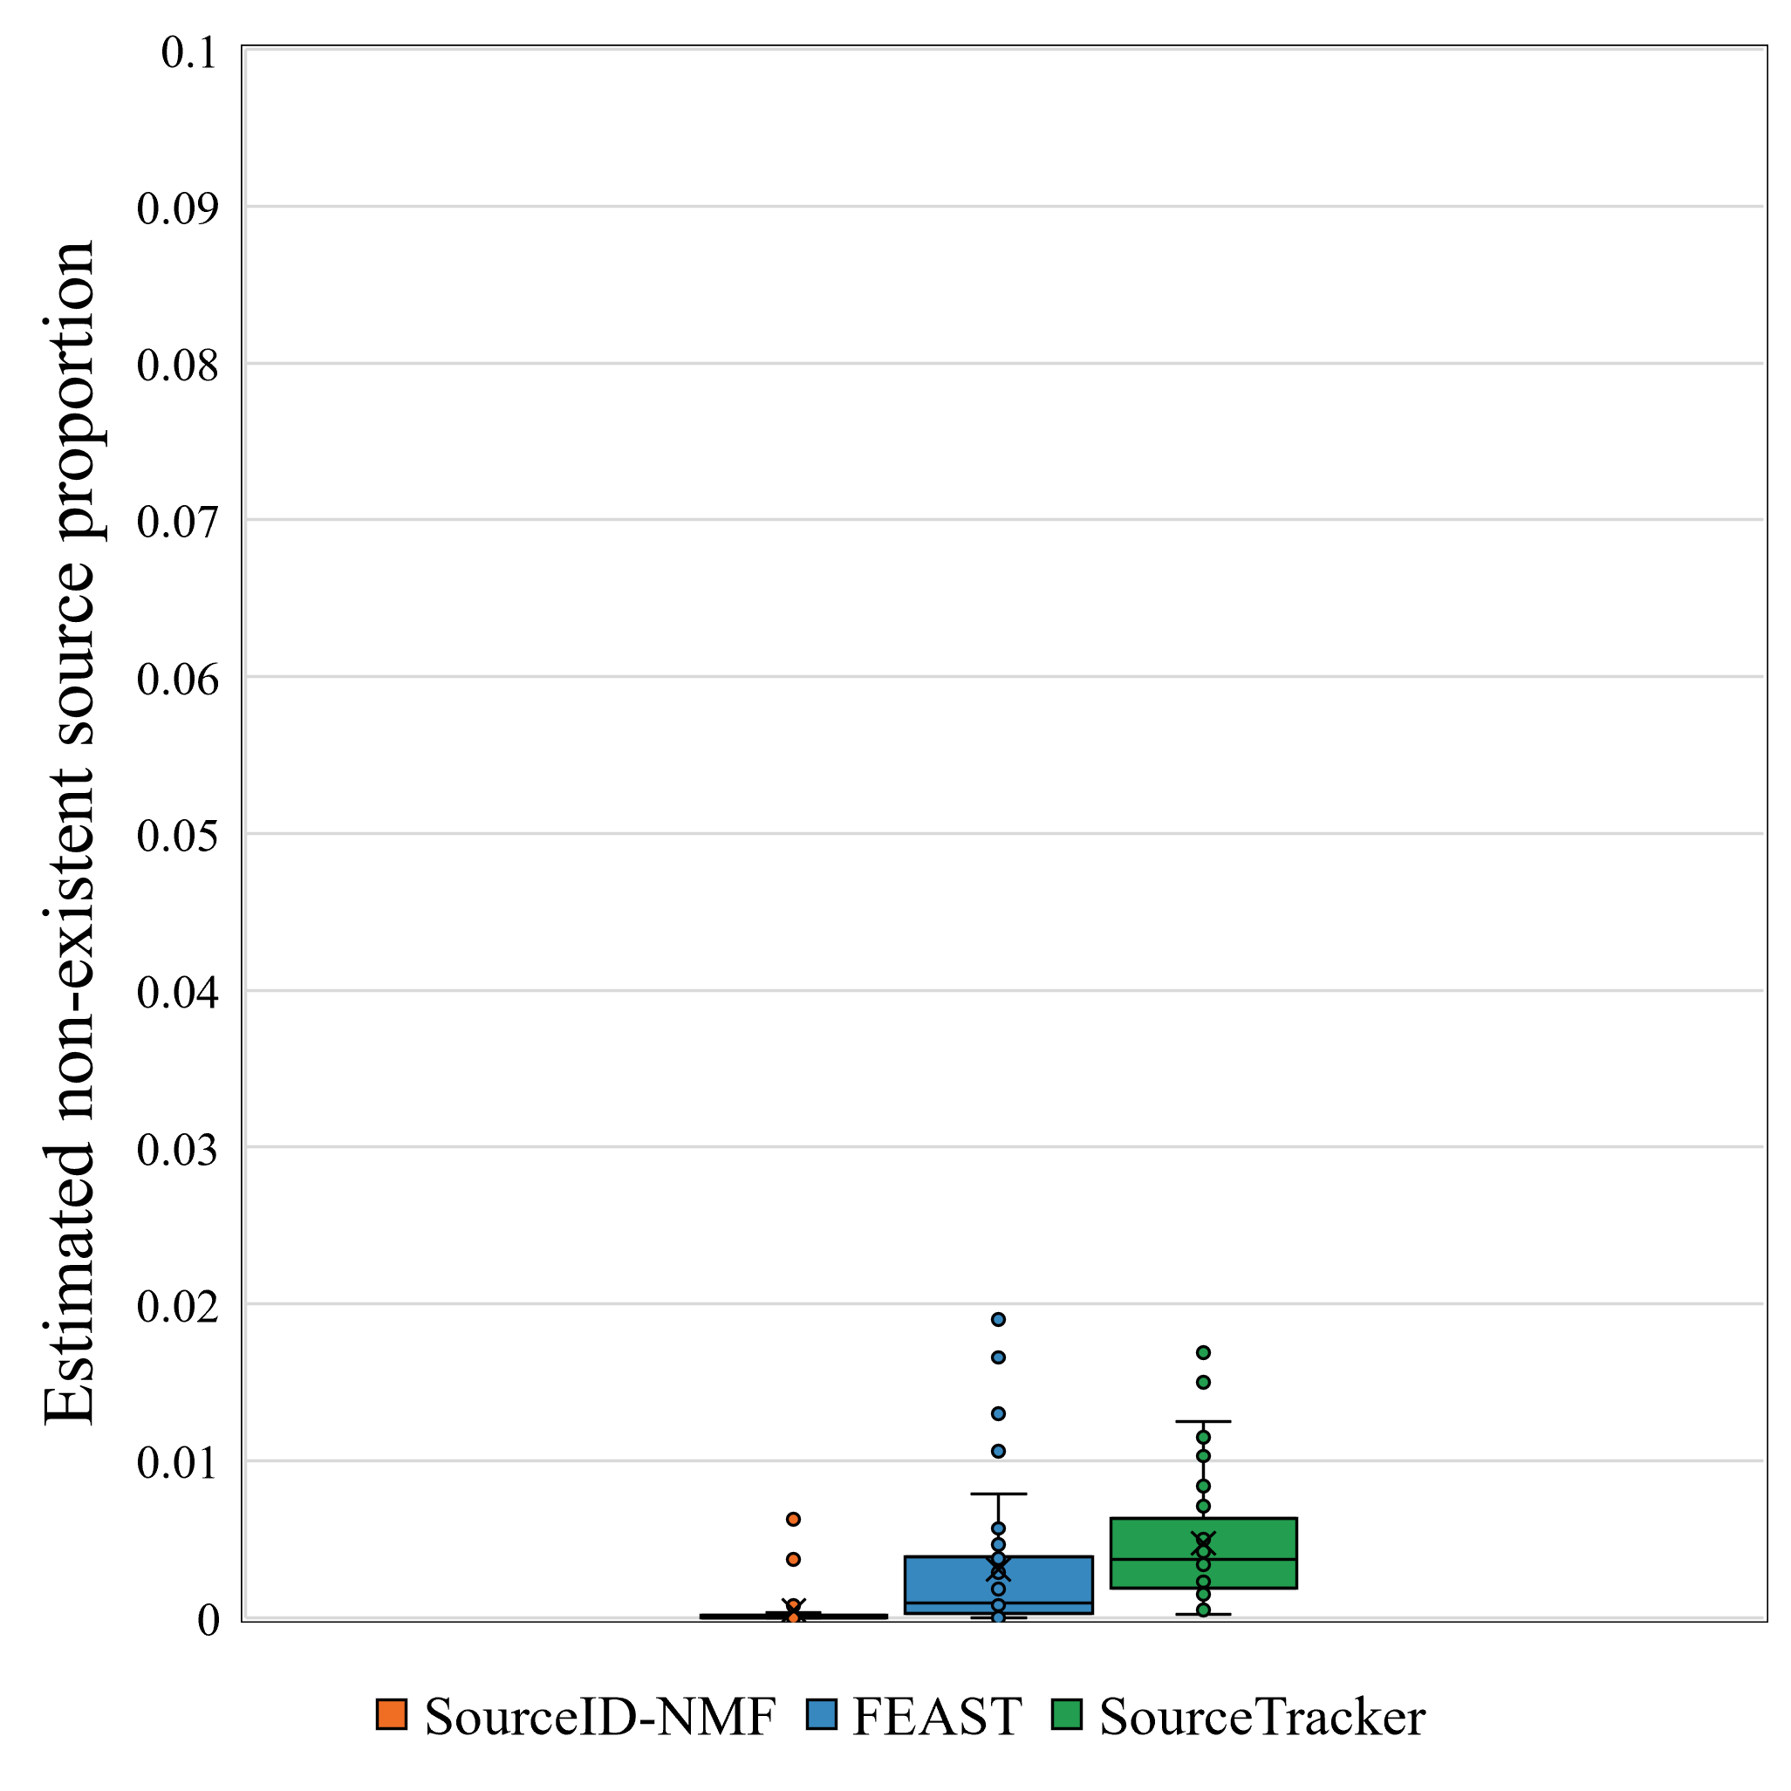
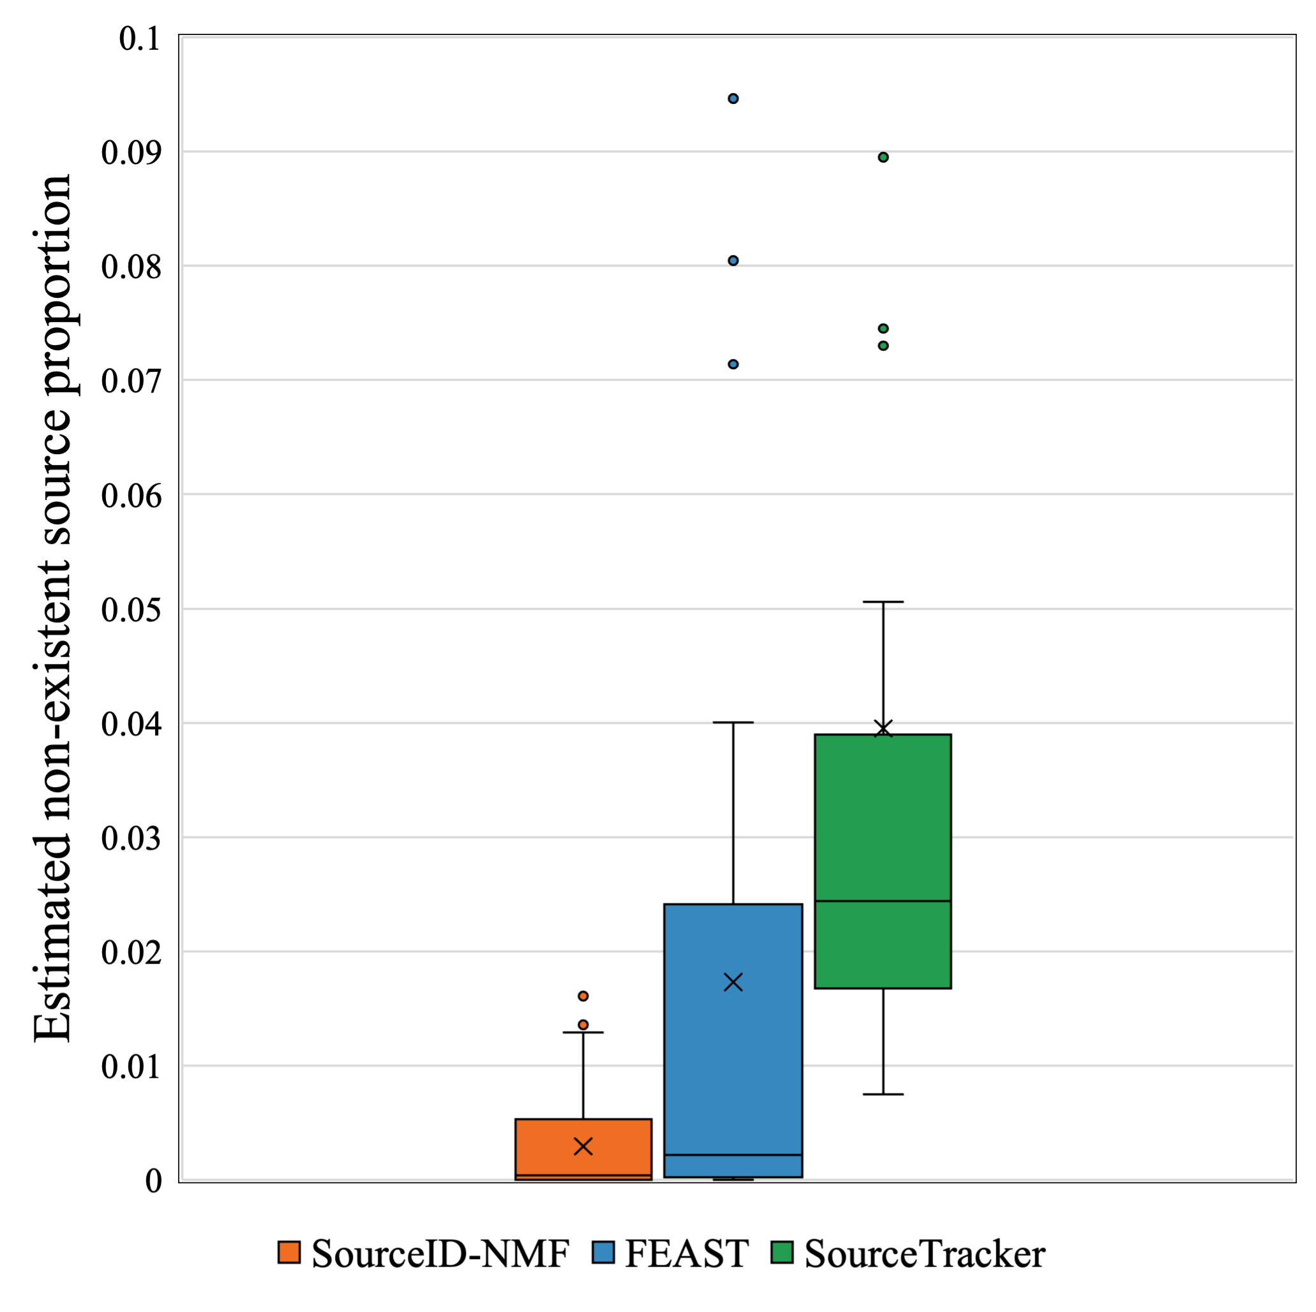
Simulated data experiment
More accurate identification of irrelevant sources (ideal value: 0)
(b) 0.8 JSD
(a) 0.6 JSD
Notes:
The figures here show how the three tools estimate the proportions of irrelevant sources. Ideally, we want the estimations to be zero as they are irrelevant. Our tool assigns almost zero proportion to most irrelevant sources. As sources become more similar, FEAST and SourceTracker tend to assign larger proportions to many irrelevant sources. Thus, our tool has better performance in identifying irrelevant sources.

Slide 17
Real data experiment
Infants’ fecal samples
Target samples: 7 fecal samples
Reference sources: 29 samples from hands, environmental surfaces, incubators, sinks, tubes, and electronics
Notes:
Here is a real data experiment. We have 7 fecal samples and 29 samples from different sources. Both tools had similar estimations of the tube source, while FEAST estimated more sources. To understand why our tool did not estimate these sources, we checked the taxa abundance of the reference samples and the target samples. We found that samples from sources other than the tube source contained many taxa. These taxa are abundant in the reference sources but missing in the target samples. This indicates that these sources may be irrelevant, so our tool assigned zero proportions to them. However, it is also possible that these sources are relevant, and the missing of these taxa in the target samples is due to sequencing issues. To further investigate, we conducted simulated experiments to simulate these two scenarios.

Slide 18
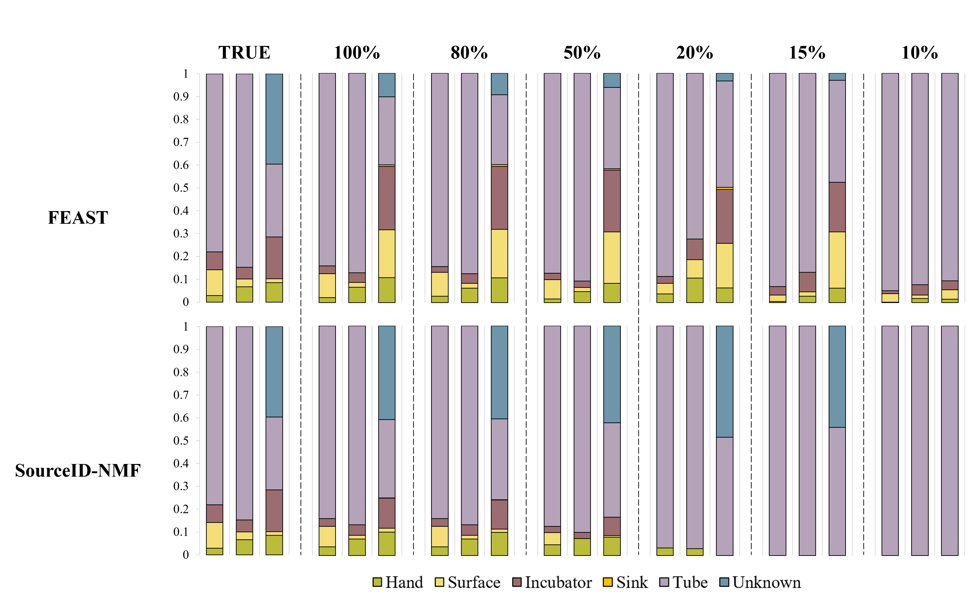
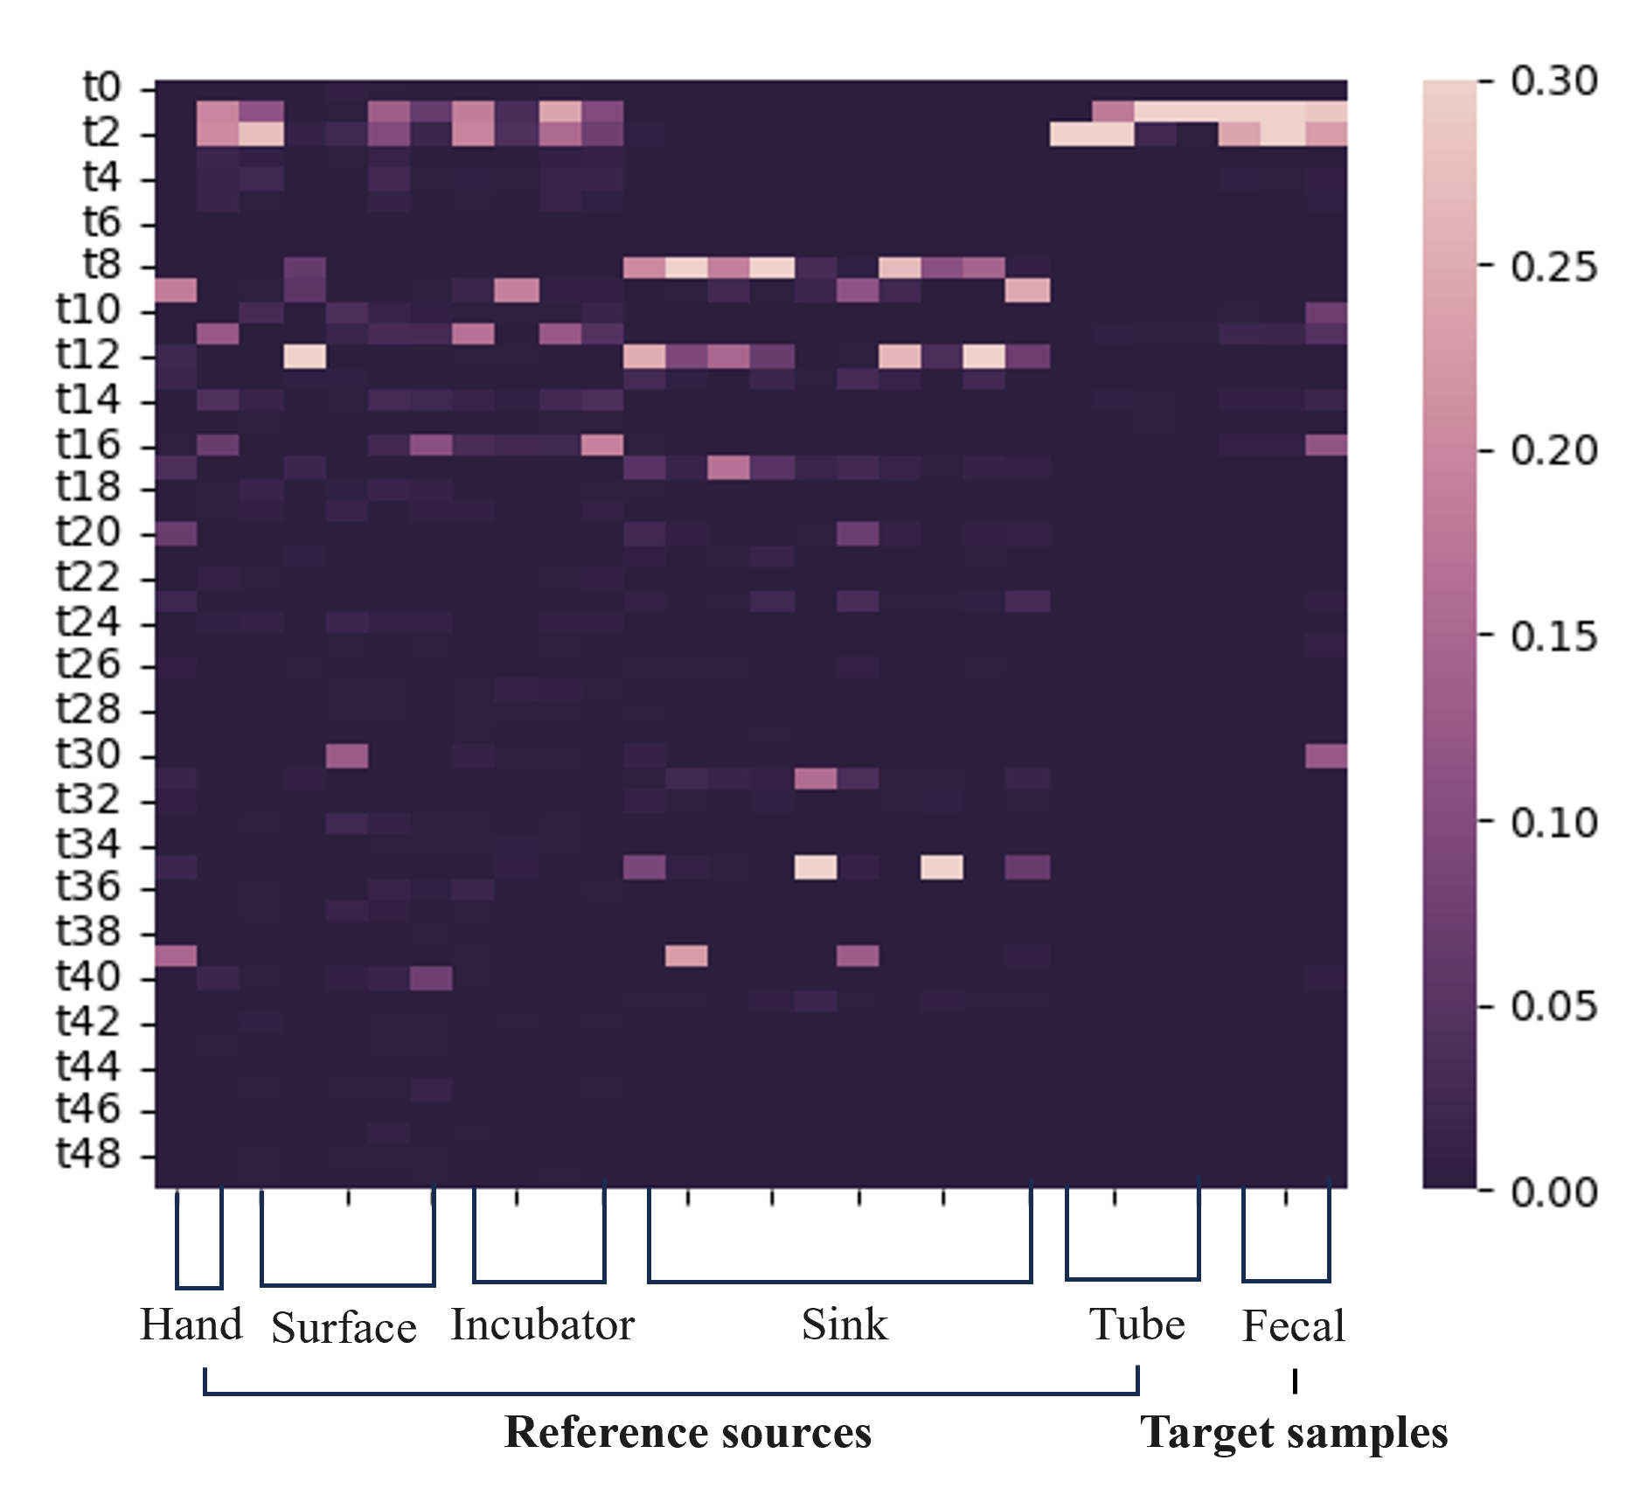
Investigate the reasons via simulation (I)
Retaining Top n% of Taxa in the Target Sample While Setting the Rest to Zero
Simulated
Retaining operation
Heatmap of the taxa abundance when retaining 20%
(highly similar to the real data)
Notes:
Suppose the target samples indeed have more sources as shown here. Then, we only reserved certain proportion of dominant taxa in the target samples and used the modified taxa abundance as input. We can see that, when 80% of low abundance taxa were removed, our tool took these low-proportion sources as irrelevant Because they have many taxa that are missing in the target samples. FEAST can identify these sources, even many taxa were removed. But it tended to overestimate the proportions of reference sources while underestimate the unknown sources. In contrast, our tool has the good estimations for the unknown sources even many taxa were removed.
This is consistent with the previous simulated experiments.
If users want to identify more sources as much as possible in this situation, we provided a strategy to find out more sources.

Slide 19
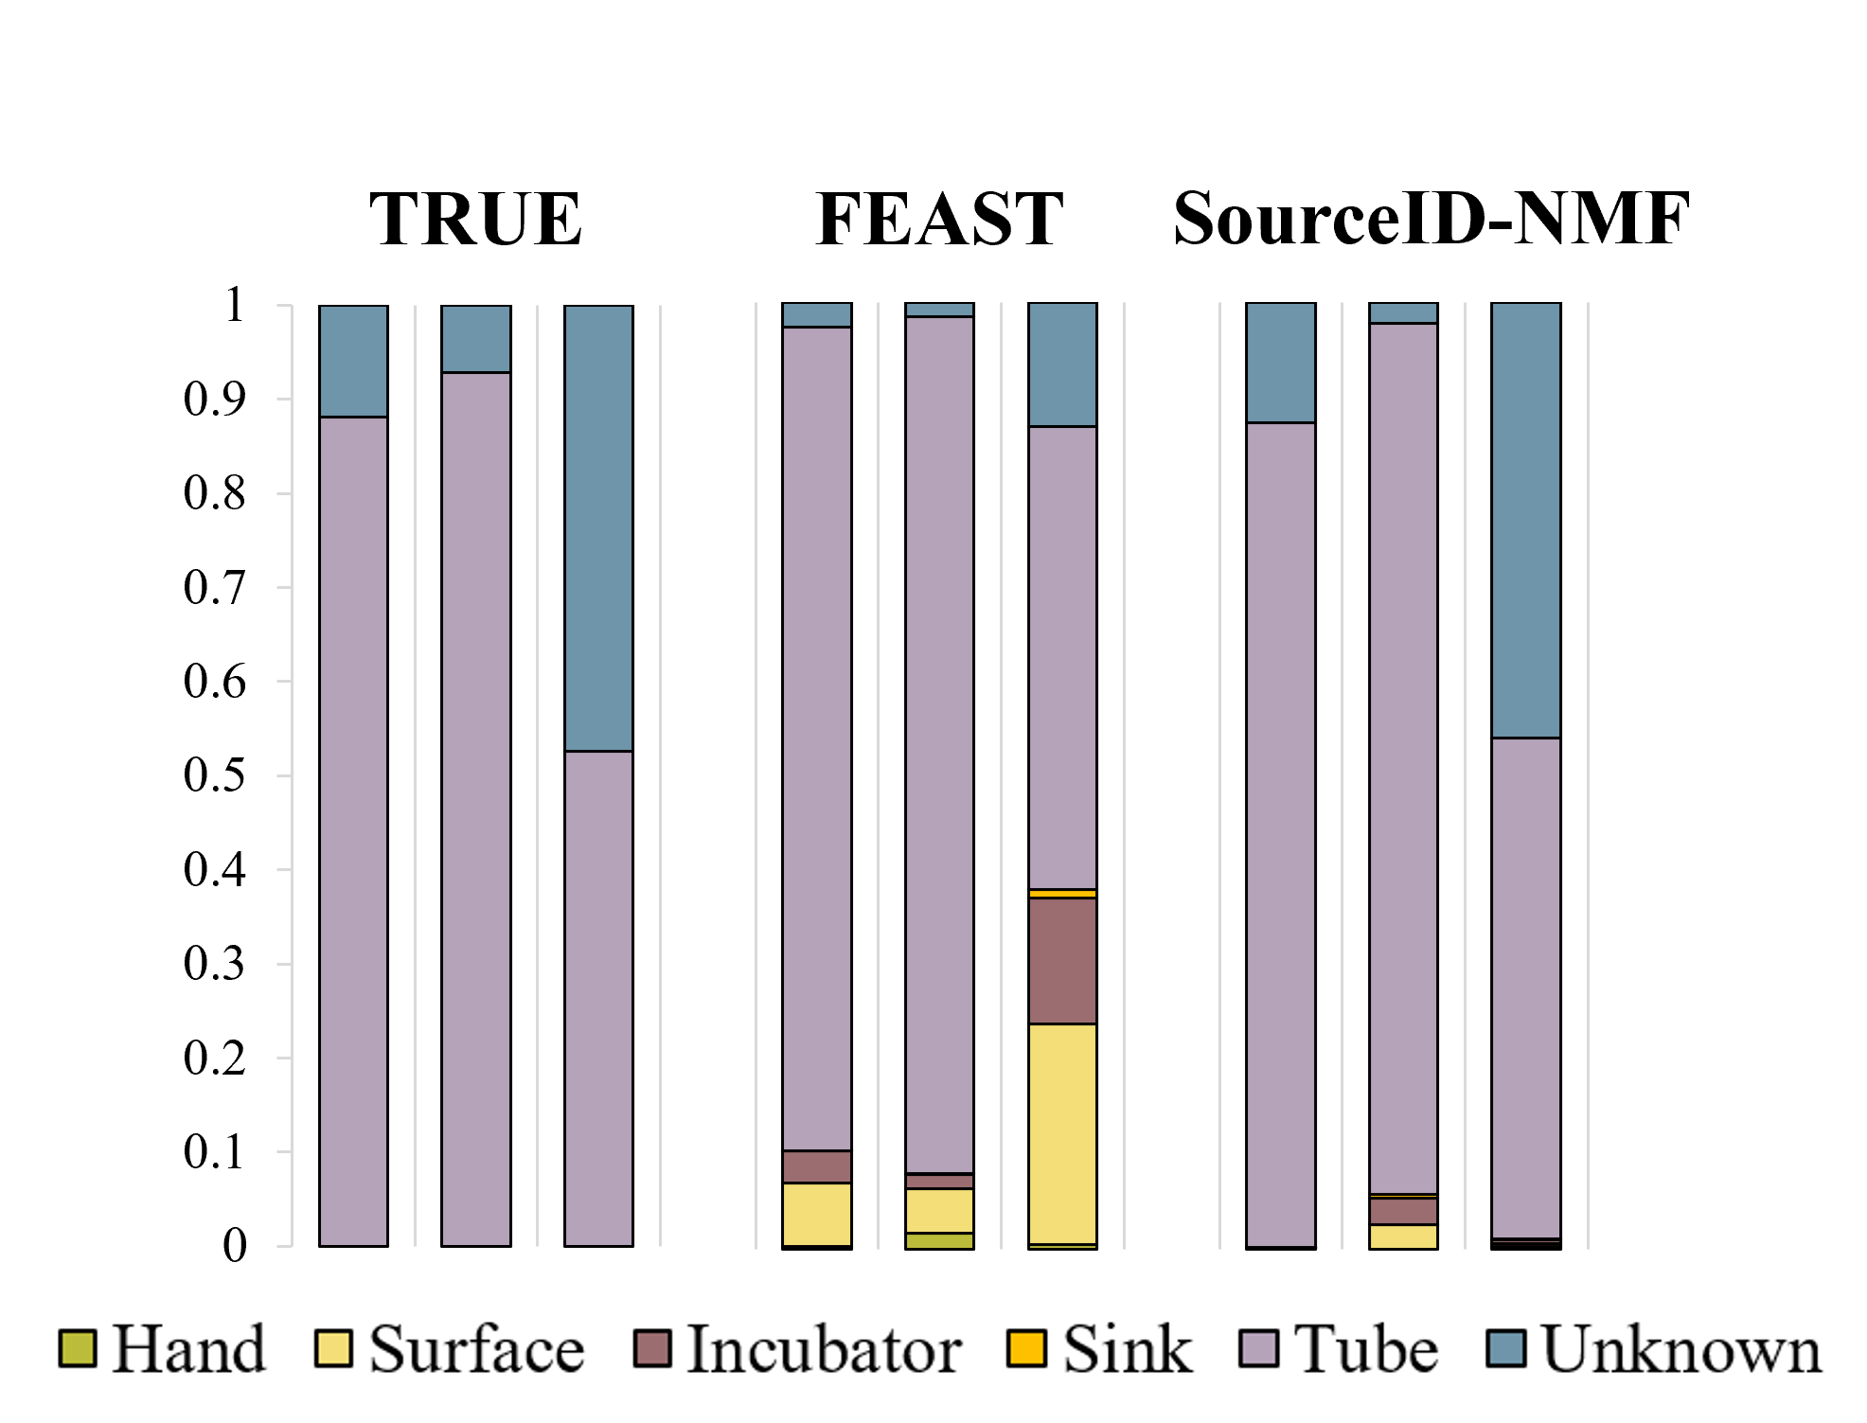
Investigate the difference via simulation (II)
Re-generate the target sample using only tube and unknown sources
FEAST can generate false positives, consistent with previous experimental results
Notes:
As I mentioned before, the rich taxa in the reference sources but missing in the targe samples may indicate that these sources are irrelevant. So, we simulated this scenario and tested two tools. We can see that FEAST overestimated the proportions of irrelevant sources because these sources also share some taxa with the target samples. Our tool assigned much smaller proportions to the irrelevant sources. So, these experiments show that our tool prefers accurate estimation of sources proportions while FEAST tended to find out more relevant sources with the sacrifice of estimating proportions.

Slide 20
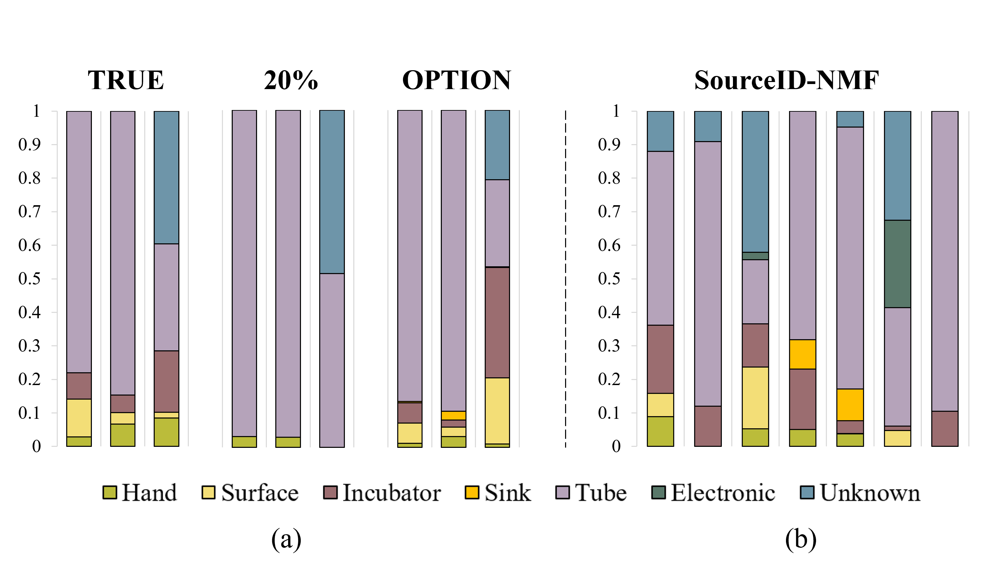
An option to include more sources
Only use taxa observed in the target samples (OPTION)
Simulated data experiment
Real data experiment
Notes:
The strategy is to only use the taxa abundance of the observed taxa in the target sample for reference sources. Our tool output more sources as relevant. Details can be found in the supplementary file in our paper.

Slide 21
Conclusions
SourceID-NMF
Goal: estimate the proportions of reference sources in a target microbial sample
Input: taxa abundance of the target samples and reference sources
Output: the proportion of reference sources and unknown source
Good at estimating sources’ proportions especially the unknown sources
Notes:
In conclusion, we developed a tool for microbial source tracking. The tool utilize a non-negative matrix factorization method to analyze the taxa abundance of the targe samples and the reference sources and output the contributions of sources. The experiments demonstrate our tool output more accurate estimation of source proportions especially the unknown sources.
Our tool is available here. You can also scan the QR code to the website.

Slide 22


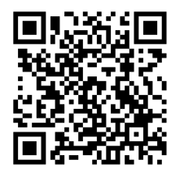
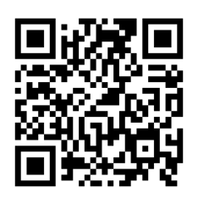
Acknowledgement
Funding: GRF, ITF, and City University of Hong Kong
GitHub of SourceID: https://github.com/ZiyiHuang0708/SourceID-NMF
Ziyi Huang
Dehan Cai
Group Website:
https://yannisun.github.io/
Notes:
Finally, I would like to acknowledge the funding support from GRF and City University of Hong Kong. And thanks to our group members especially my supervisor Prof. Sun. Here is the QR code of our group website. And I would like to acknowledge the contribution of Ziyi Huang. He is one of the co-first author of this work. Thanks for your attention!

Slide 23
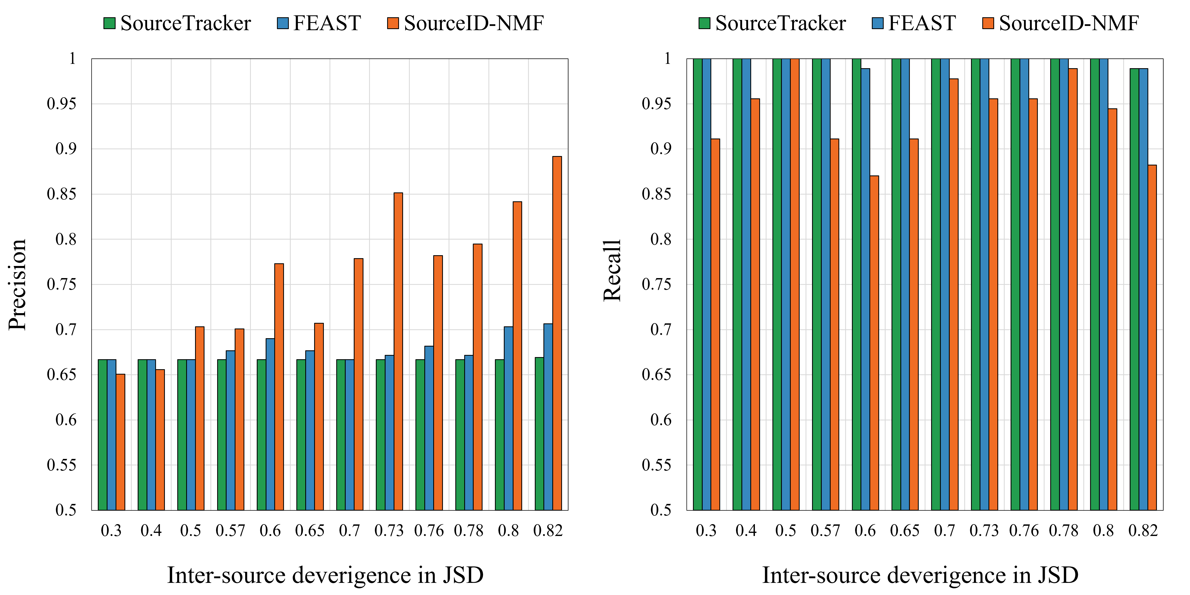
Simulated data experiment
Source tracking by ignoring specific proportions
A threshold of 1E-06 was set to determine source identification.

Slide 24
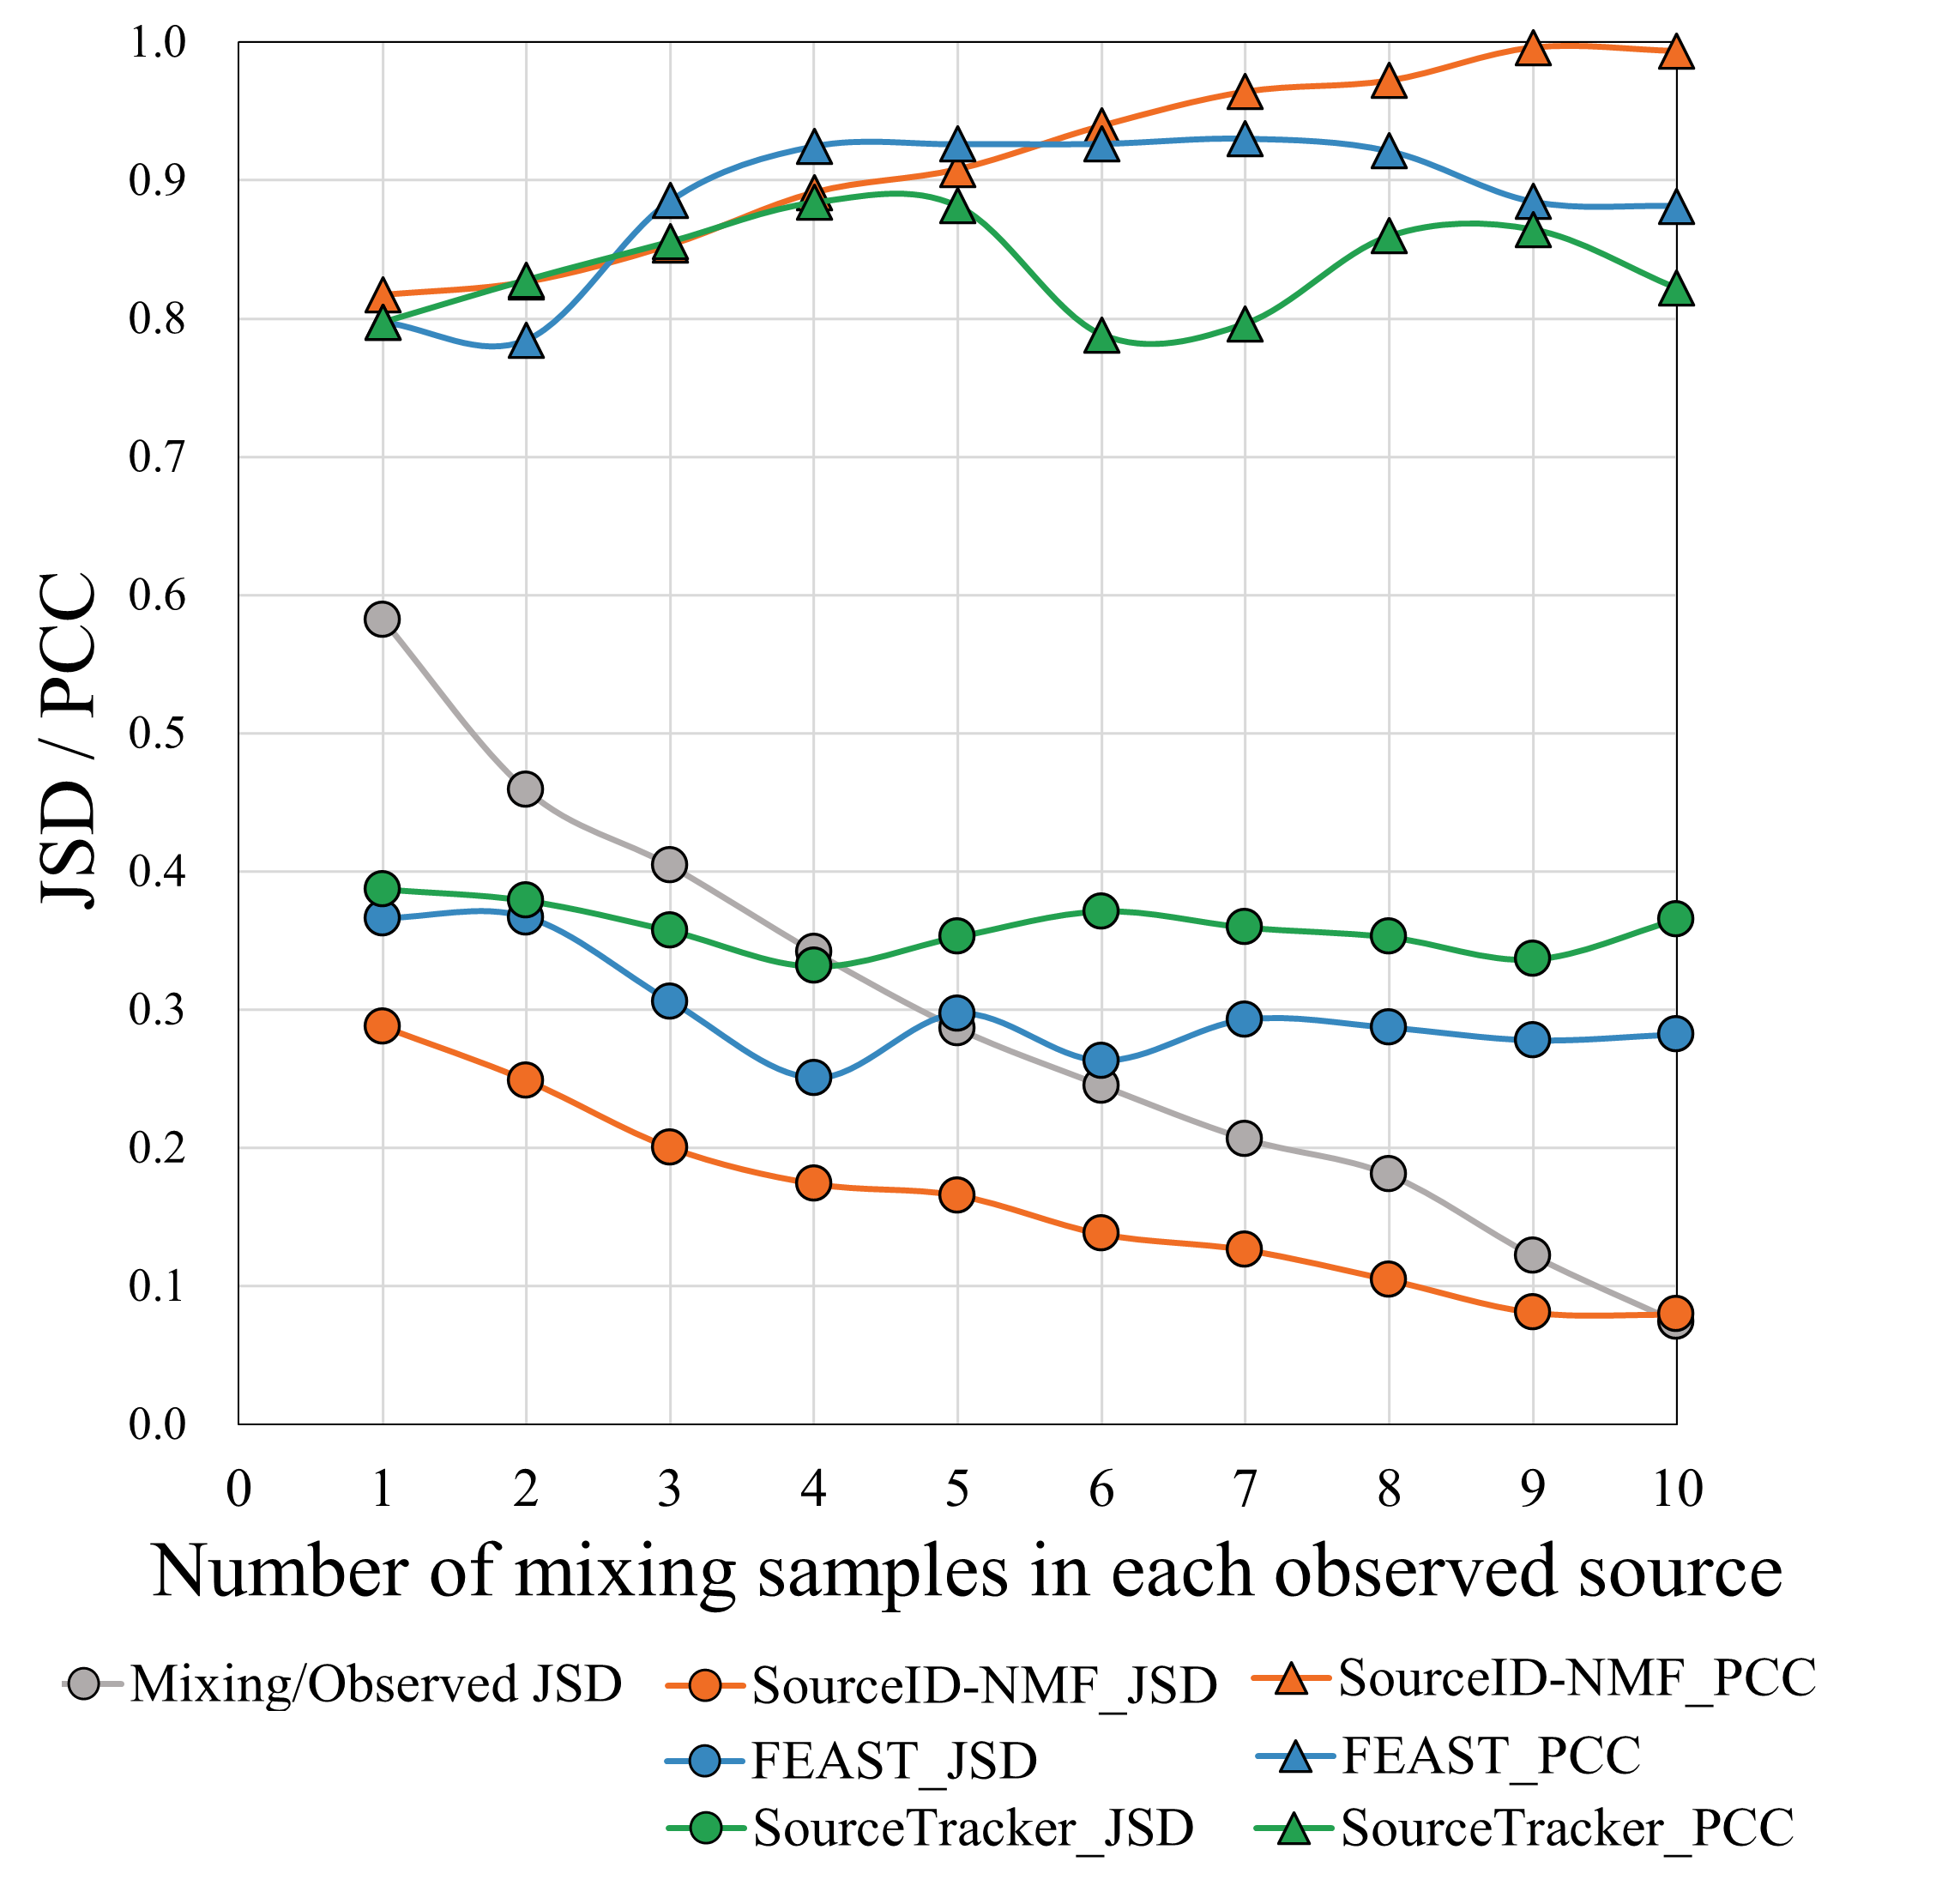
Simulated data experiment
Reference sources with noises

Slide 25
Real data experiment
Indoor environmental samples
Target samples: 6 Indoor environmental samples
Reference sources: 180 microbial samples from from gut, oral, skin and soil (45 samples for each)
No space-time correlation

Slide 26
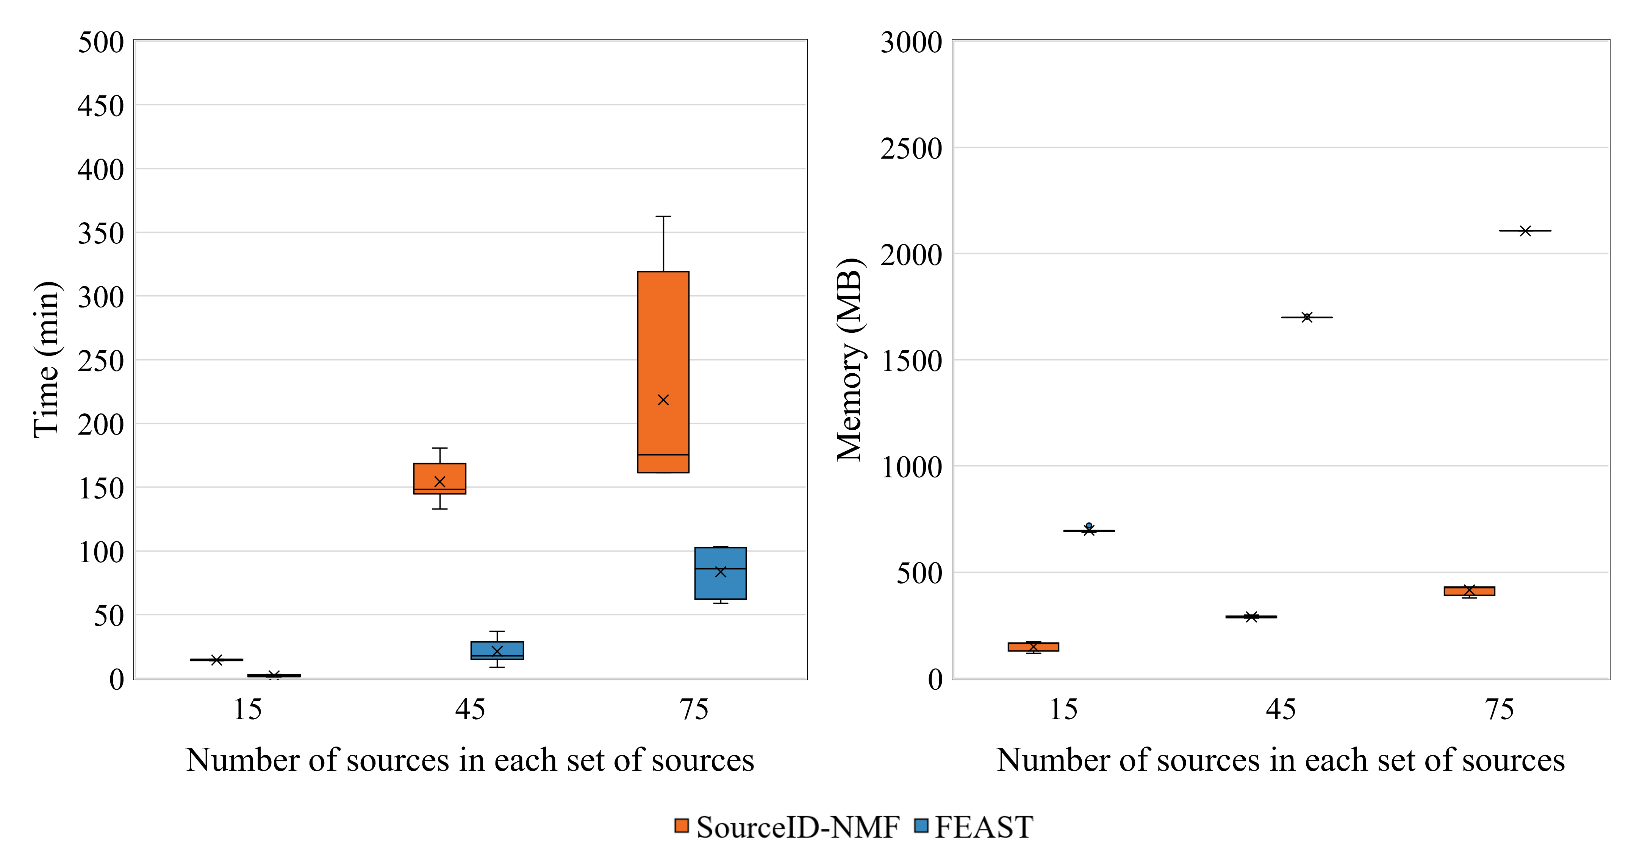
Running time and Memory Usage

Slide 27
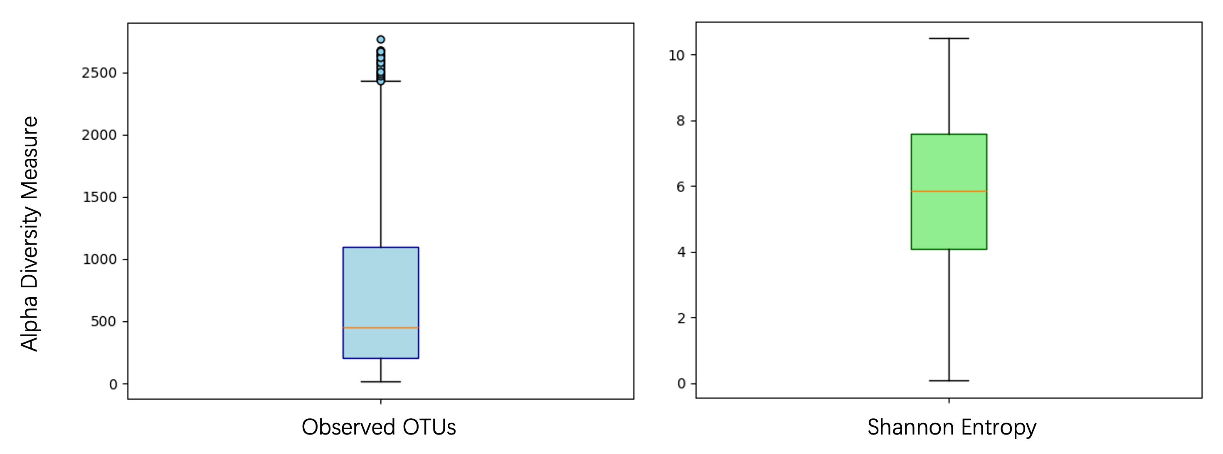
Alpha diversity
Earth’s microbiome project

Slide 28
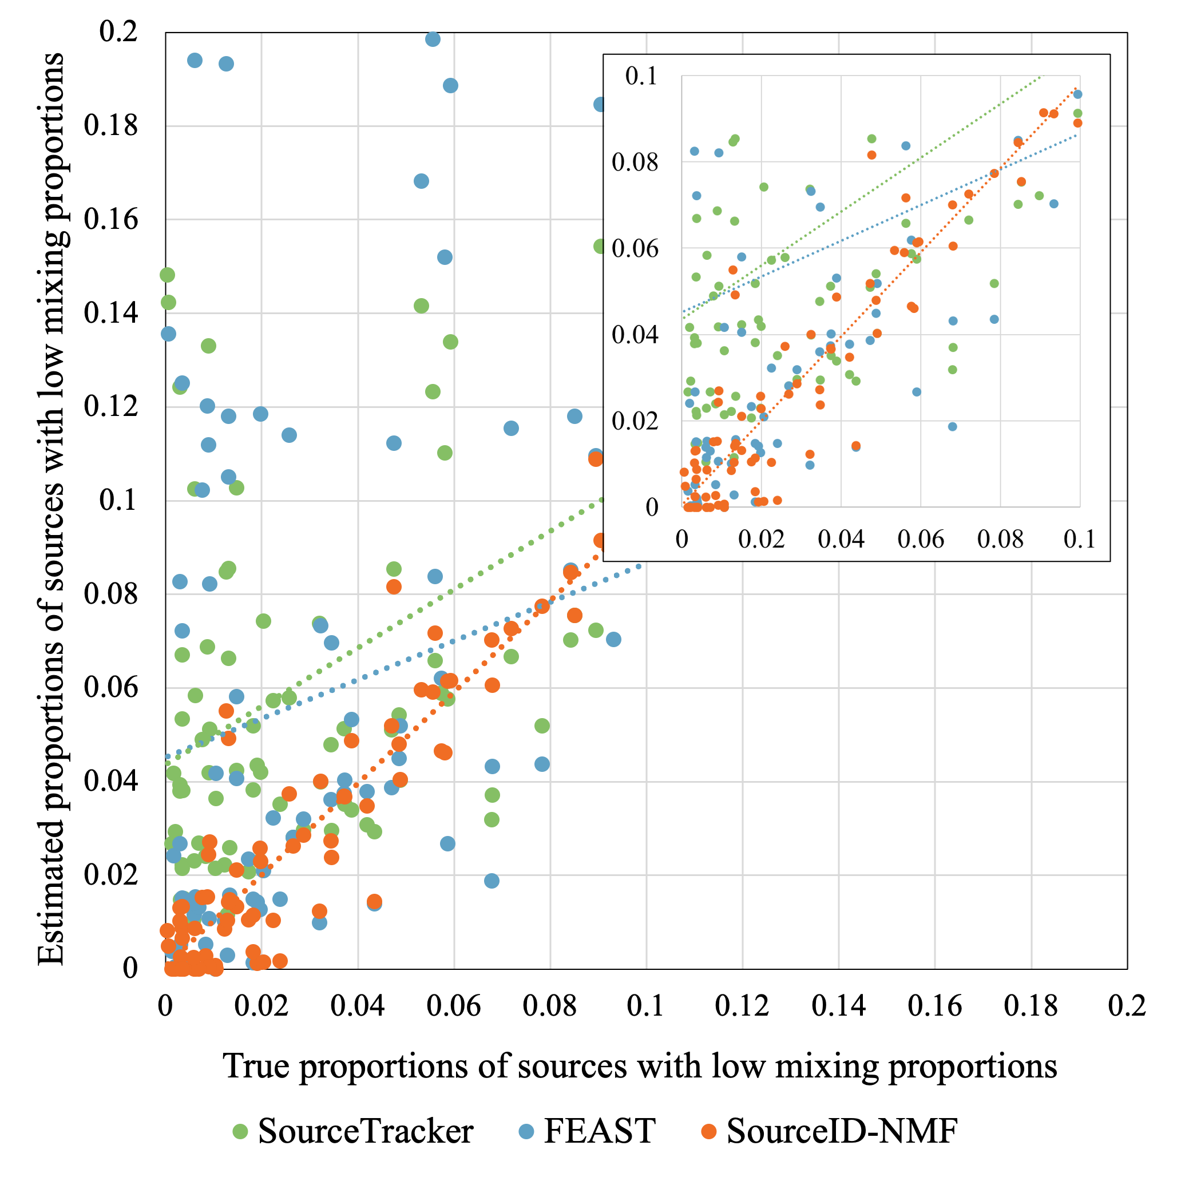
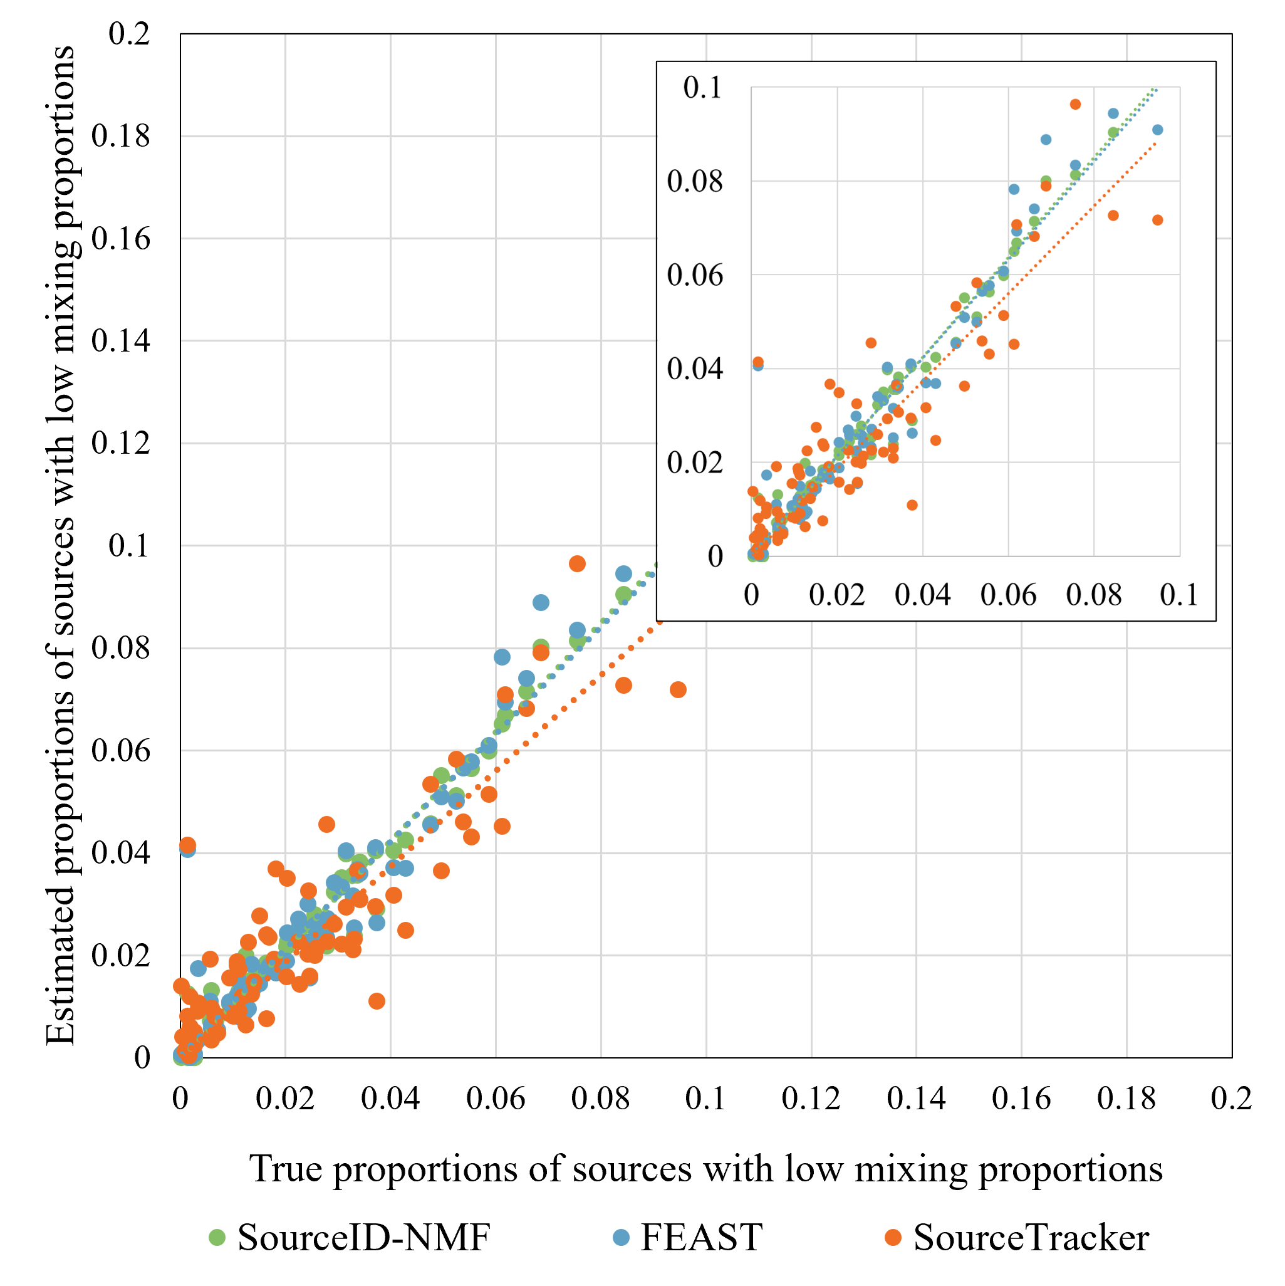
Sources with small proportions
(a) 0.6 JSD
(b) 0.8 JSD

Slide 29
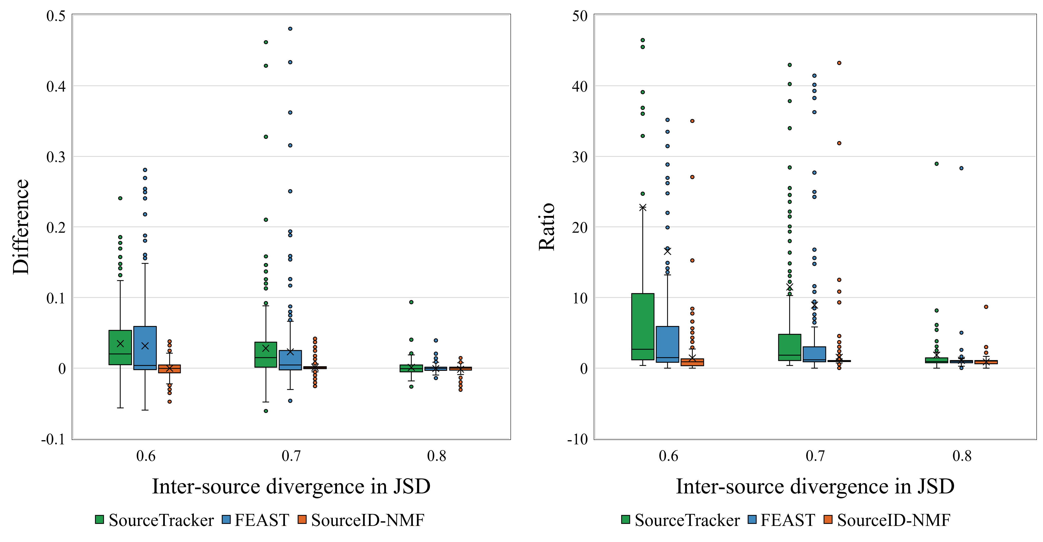
Sources with small proportions
The boxplots of the estimated proportions for the low abundance sources (below 0.1 proportions). Difference and Ratio (estimation divided by the ground-truth) between estimated proportions and true proportions.
Notes:
Ratio: > 1 means overestimate, < 1 means underestimate, ==1 means accurately estimate

